Slide 1
Statewide Assessment Training 2018 WY-TOPP

Slide 2
Objectives
Prepare for a successful test administration.
Examine test security standards.
Provide accommodation resources.
Present allowable resources for online and paper testing.
Explain the exemption request process.
Outline Building Coordinator Responsibilities.
Outline Test Administrator Responsibilities.

Slide 3
Department Contacts
Wyoming Department of Education Assessment Staff
Laurie Hernandez, WY State Director of Standards & Assessment
laurie.hernandez@wyo.gov
Jessica Steinbrenner, Assessment Supervisor
jessica.steinbrenner@wyo.gov
Michelle Carroll, Assessment Consultant
michelle.carroll@wyo.gov
Catherine Palmer, Assessment Consultant
catherine.palmer@wyo.gov

Slide 4
Websites
Wyoming Assessment Portal
https://wyoassessment.org/
Wyoming Department of Education State Assessment Webpage https://edu.wyoming.gov/educators/state-assessment/

Slide 5
Manuals
Testing
TIDE User Guide
Test Administration Manual – Spring Summative
Test Administration Manual – K-2 Spring Interim
Test Administrator User Guide
Technology
Secure Browser Installation Manual
Technical Specification Manual for Online Testing
System Requirements for Online Testing

Slide 6
WY-TOPP
Wyoming Test of Proficiency and Progress
Online adaptive assessment
Item difficulty, not cognitive complexity, adjusts to student performance
Covers breadth of standards for grade level using a variety of items types
Grades 3-10 will test in ELA and Math
Grades 3, 5, 7, & 9 will also assess Writing
Grades 4, 8, & 10 will also assess Science

Slide 7
Helpdesk
AIR Helpdesk
1-888-897-8024
wyohelpdesk@air.org

Slide 8
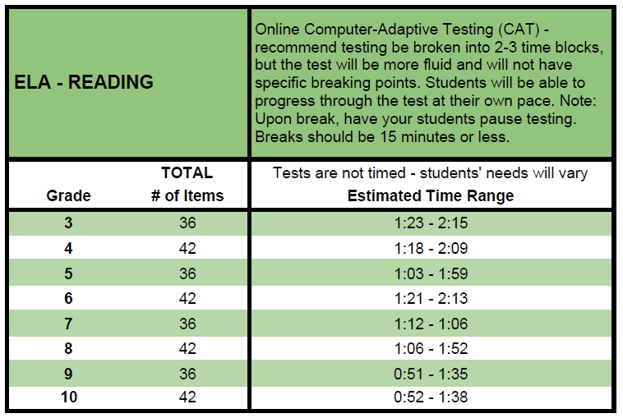
Estimated Testing Times
*Note: Adequate time must be provided for make-up administrations. Make-up administrations must be completed by the end of the Test Administration window.

Slide 9
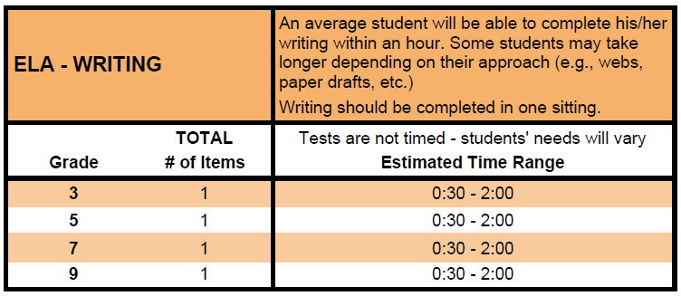
Estimated Testing Times - ELA
*Note: Adequate time must be provided for make-up administrations. Make-up administrations must be completed by the end of the Test Administration window.

Slide 10
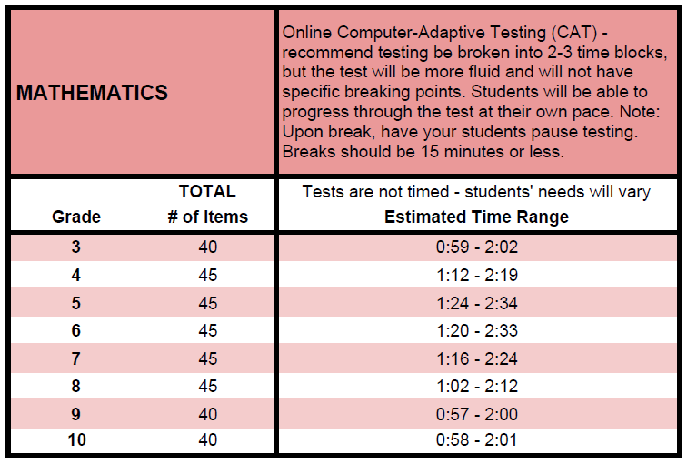
Estimated Testing Times - Math
*Note: Adequate time must be provided for make-up administrations. Make-up administrations must be completed by the end of the Test Administration window.

Slide 11
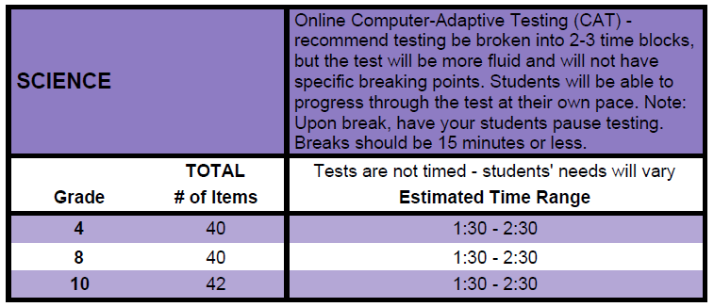
Estimated Testing Times - Science
*Note: Adequate time must be provided for make-up administrations. Make-up administrations must be completed by the end of the Test Administration window.

Slide 12
Any questions?

Slide 13
Test Security

Slide 14
Test Security
The primary goal of WY-TOPP test security is to protect the integrity of the assessments by
Securing test materials and items at all times
Ensuring appropriate preparation for and administration of the test

Slide 15
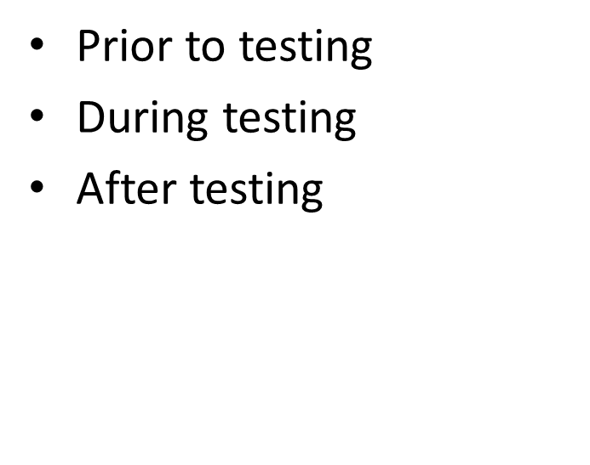
Test Security
WHEN
WHO
District Coordinator
Building Coordinator
Proctors and Test Administrators
Anyone who handles the tests

Slide 16
Consequences of Test Security Breaches
Inferences cannot be drawn about student performance
Items may be unusable in future tests, resulting in additional costs for item development
Students gain an unfair advantage
Violates public trust
Invalidation of scores may affect accountability calculations

Slide 17
Online Test Security
Secure Browser
Prevents students from accessing other programs or the internet during testing.
Any attempt to leave the secure browser or access the student computer from another device will log the student out of the test.

Slide 18
Home School Students
It is a district choice whether to test home school students.
Home school students who do test MUST test in their district of residence. DO NOT test a home school student who is not a resident in your district.
Campuses that agree to test a homeschool student must complete a Test Security Agreement specifically for that student.
If you do test home school students, your district is responsible for mailing the ISRs to the parents.
Scores of home school students will not be counted in accountability calculations.

Slide 19
Test Security Reporting
INITIAL REPORT ALLEGING A SPECIFIC VIOLATION
A test security violation is reported and received by WDE from any individual or school or district alleging that a specific breach in test security has occurred in an individual district or testing site.
1
2
INITIAL WDE REVIEW OF POTENTIAL TEST SECURITY IRREGULARITY
WDE to review breach. If determined to be outstanding WDE will send to AIR for review .
AMERICAN INSTITUTES FOR RESEARCH REVIEW
The AIR Internal Test Security Review Team reviews all reports brought to the team to determine how best to resolve the allegation by analyzing the severity of the alleged breach of test security and the scope of potential harm the breach may bring to the integrity of assessment results.
3
4
Telephone assistance from WDE to the DTC .
5
Letter from WDE Assessment Director re: findings. May invalidate scores.
6
Districts may choose additional consequences related to personnel contracts / local context.

Slide 20
Testing Irregularity
Irregularities are circumstances that may compromise the reliability and validity of test results. They may result in disciplinary action and could affect a school’s accountability calculations. Testing irregularities may occur before, during, or after testing and must be reported immediately.
Irregularities can include but are not limited to:
Allowing students materials that are not included with the approved IEP or 504 plan
Students cheating and/or copying the test
Inappropriate Test Preparation
Security Breaches
Irregularities are reported in TIDE

Slide 21
Test Appeals
On rare occasions, a non-standard situation arises during test administration that requires action. Appeals that require action in TIDE are listed below. These appeals require state approval.
Reset a Test – Ex. When an accommodation is not turned on or students log in using incorrect WISER ID
Reopen a Test
Reopen a Test Segment
Grace Period Extension – Use if test session was interrupted due to a fire drill or lock down
Test Invalidation – Use if a student cheated or used inappropriate materials.
Report Test Irregularity – Use if an irregularity occurs
that does not fit into any of the above appeals.
Ex. A cell phones rings.

Slide 22
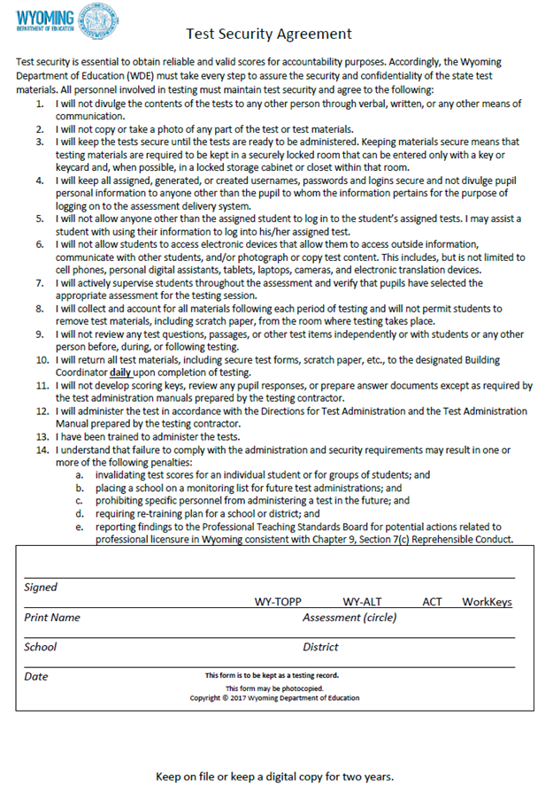
Security Agreement Form
Make sure each person handling test materials signs and returns this form to the Building Coordinator
Agreement is good for 12 months
Agreement must be kept on file for 2 years
Can be found at https://edu.wyoming.gov/educators/state-assessment/test-security/

Slide 23
Accommodations and Test Settings
Accommodations and test settings should be selected in TIDE prior to the test day. If an accommodation or test setting is edited during testing, the student will need to exit the exam and an appeal must be submitted for the test to be restarted.

Slide 24
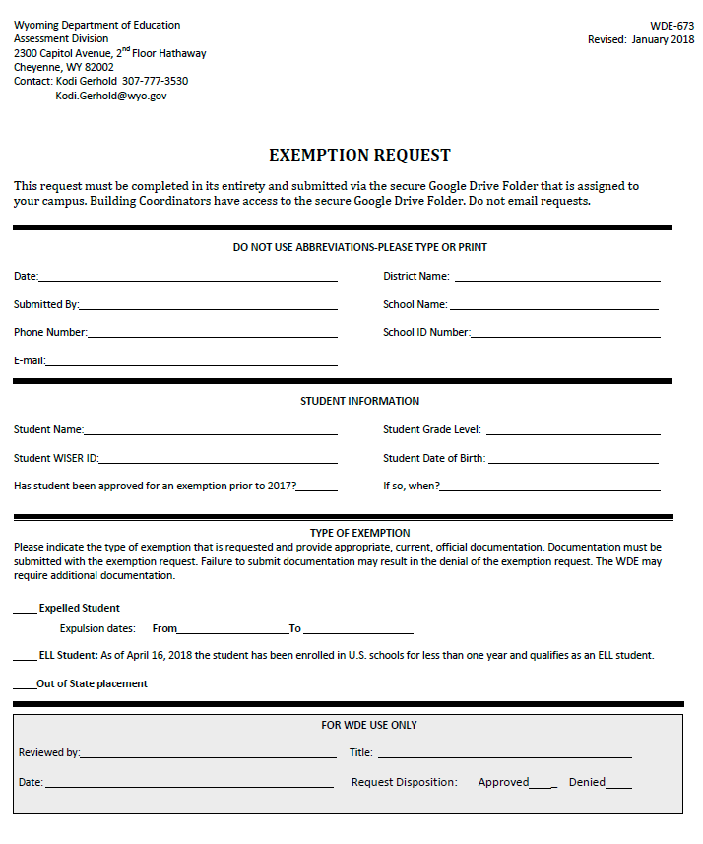
Exemption Request Process
Step 1) Request access to your secure Google folder from catherine.palmer@wyo.gov or michelle.carroll@wyo.gov
Step 2) Submit your completed exemption request form and corresponding documentation by uploading the document(s) into the ‘Submit’ Google drive folder.
Step 3) Check the ‘Decisions’ Google drive folder to confirm your request was accepted.
WY-TOPP Exemption requests are due to WDE by April 23rd.

Slide 25
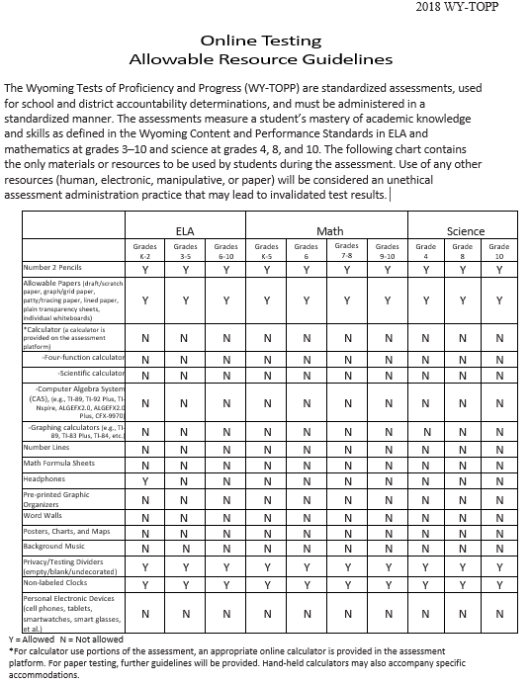
Allowable Resources
Review Allowable Resources for Online and Paper testing
Can be found at this link for online testing and this link for paper testing.

Slide 26
Questions before we move on?

Slide 27
Building Coordinator (BC) Responsibilities
Before Testing
View District Coordinator Training Video (2 hours)
Complete the online Test Administrator Training
Read the TIDE Manual
Read the Test Administration Manual
Assign accommodations and review student information in TIDE
Verify User Accounts in TIDE and check that TAs have a ‘Y’ in the TA Certified column.
Review the Technical Specification manual, set up computers, and test the system
Create a Test Administration Plan and Calendar
Train Test Administrators and Proctors
Review Allowable Resources
Submit exemption requests to the department
Collect Security Agreements
Review Quality Assurance Checklist for Secure Testing

Slide 28
Building Coordinator (BC) Responsibilities
Before Testing
Distribute materials to test administrators
Work with test administrators to make sure the testing environment is without distraction
Work with test administrators to ensure students needing accommodations are provided and correctly documented in TIDE
Ensure testing sections are administered appropriately
-Review testing schedule. On grades 3, 5, 7, & 9
ELA with Writing assessment, TAs should only approve students entry into the Writing segment if there is time for students to complete their writing in one sitting.

Slide 29
Building Coordinator Responsibilities
During Testing
Be available to address accommodation changes
Document any possible testing irregularities or appeals in TIDE
Follow established testing schedule
Monitor for allowable resource use

Slide 30
Building Coordinator Responsibilities – After Testing
After Testing
Collect and account for all test materials from Test Administrators immediately after testing is complete
Submit test appeals or irregularities in TIDE
Remove any allowable paper resources and destroy onsite

Slide 31
Test Administrator (TA) Responsibilities
Before Testing
Complete the online Test Administrator Training
Access Resources and read the Test Administration Manual and User Guide
Verify User Account in TIDE
Administer Training Tests
Verify Student Accommodations and Test Settings
If you notice an error on the selected accommodations in TIDE, please inform the building coordinator.
Prepare Testing Materials
Adhere to test security procedures

Slide 32
Test Administrator (TA) Responsibilities
During Testing
Distribute Materials
Test Administrator Log in to the TA Interface
Select Tests to Administer
Note Session ID
Help Students Log in to the Test Session
Approve Students for Testing
During the ELA with Writing assessment, TAs must approve entrance to the writing segment, which is after the ELA segment. TAs should not approve entry into the writing segment if there is not enough time for students to complete the writing.
Grade 6 math has two segments: with calculator and without calculator. TAs will not need to approve students’ entrance into the second segment.
Adhere to test security procedures
Read Scripted Directions
Communicate Test Irregularities to Building Coordinator

Slide 33
Test Administrators (TA) Responsibilities
After Testing
Adhere to test security procedures
Communicate Test Irregularities to Building Coordinator
Check that students have completed and submitted the assessment
Collect all paper materials used during the assessment.

Slide 34
Questions

Slide 35
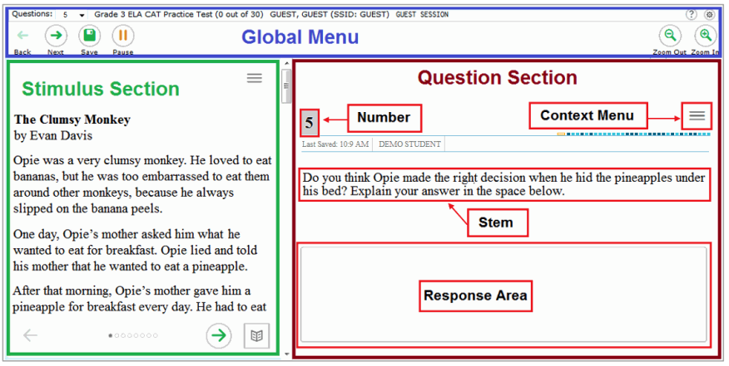
Test Layout

Slide 36
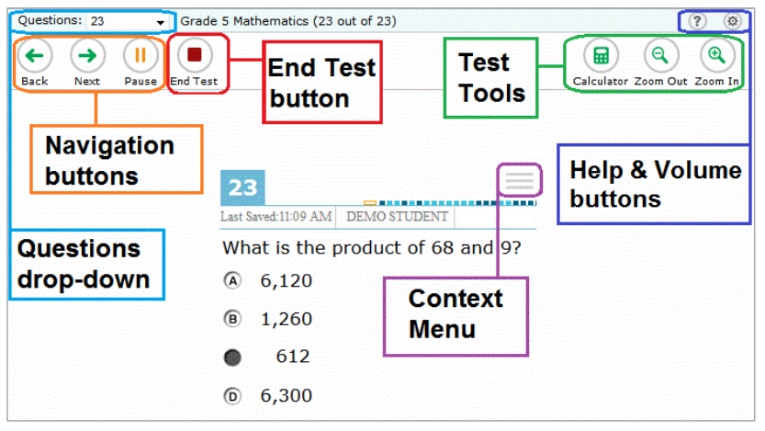
Testing Tools

Slide 37
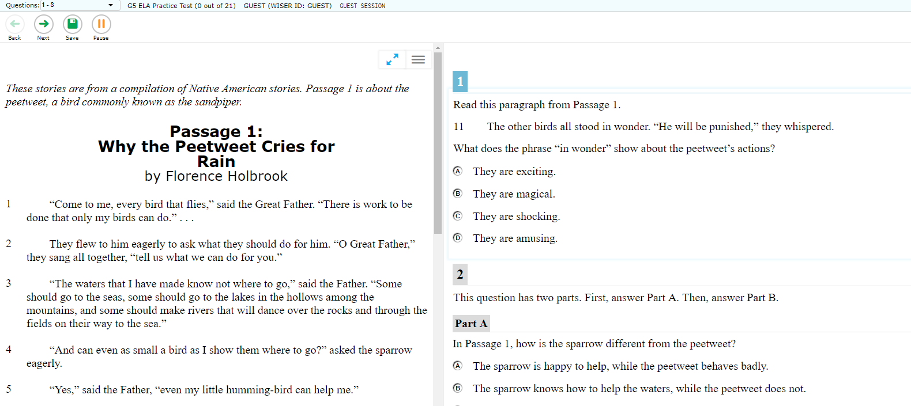
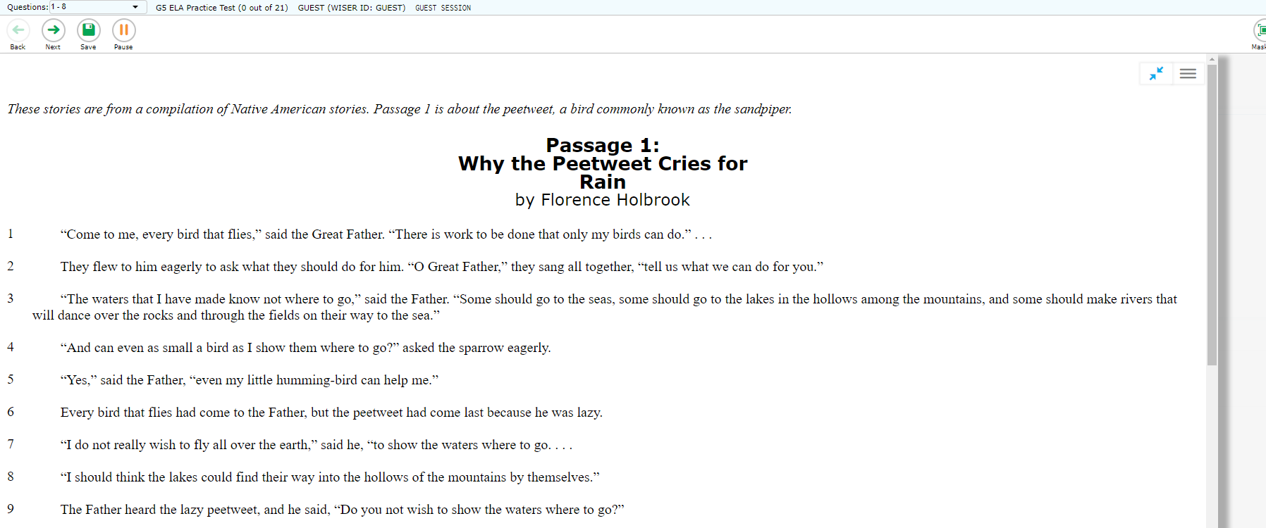
Expandable Passages
Expandable passages
Click on the double blue arrows to expand and/or contract passages.

Slide 38
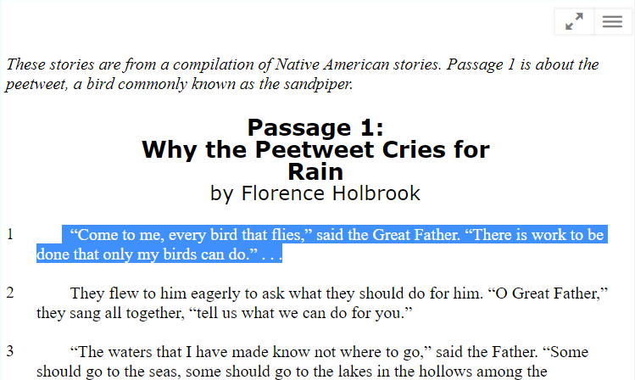
Highlight selection
Highlight selection
-First, select part of a passage.
-Then, click on the context menu icon.
-Finally, choose ‘Highlight Selection’.

Slide 39
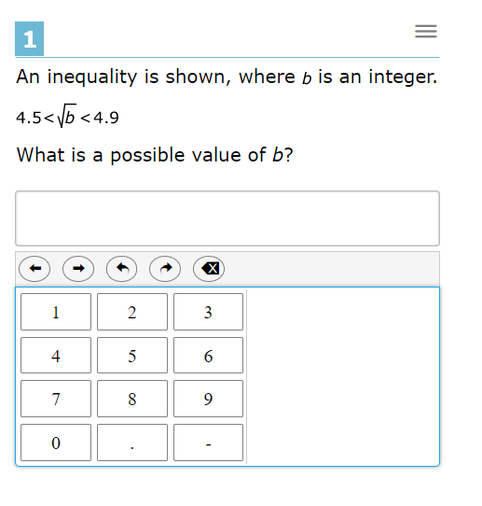
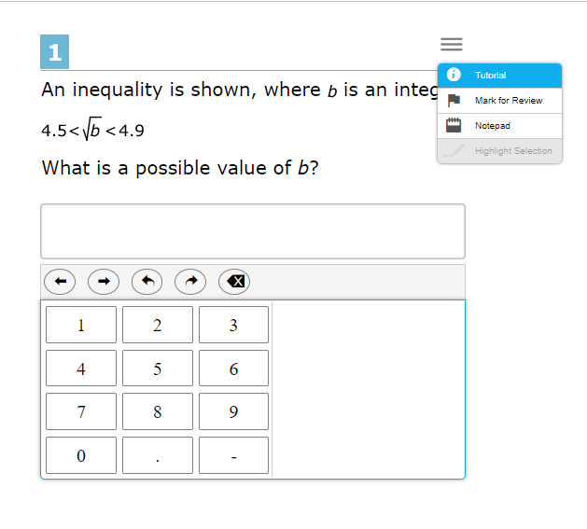
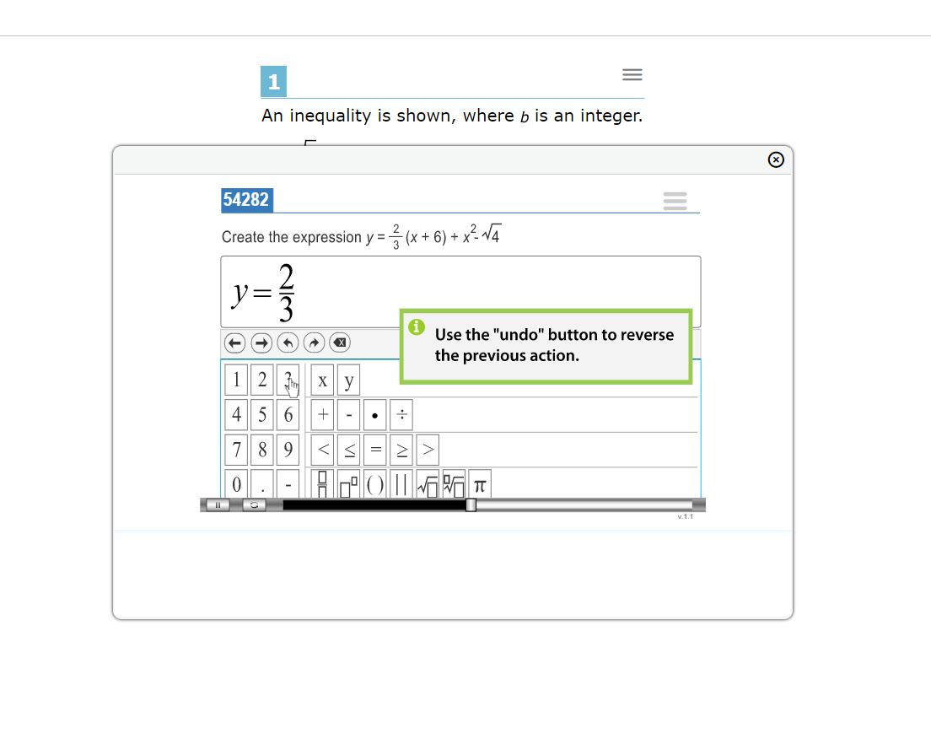
Tutorial
Tutorial – explains how to navigate through different item types.
-First, click on the context menu icon.
-Then, choose ‘Tutorial’.
-Finally, a video tutorial will pop-up on the screen. The tutorial does not include sound.

Slide 40
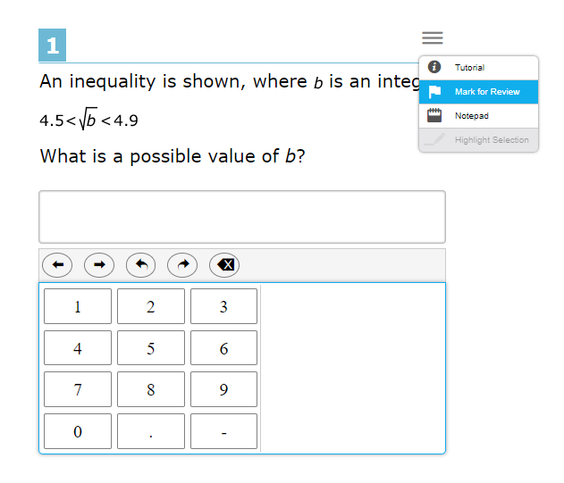
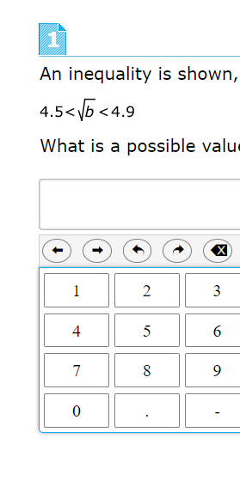
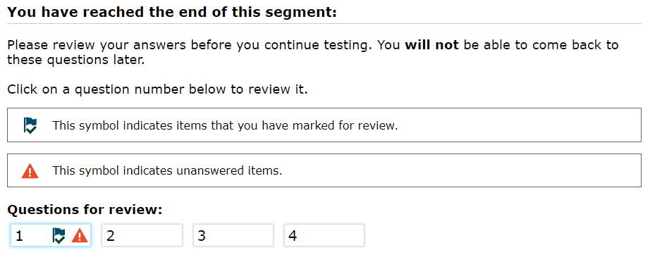
Mark for Review
Mark for Review
-First, click on the context menu icon.
-Then, choose ‘Mark for Review’.
-Notice, the corner of the item number will appear to be folded down.
-Finally, at the end of the segment or test, items that were marked for review will be flagged.

Slide 41
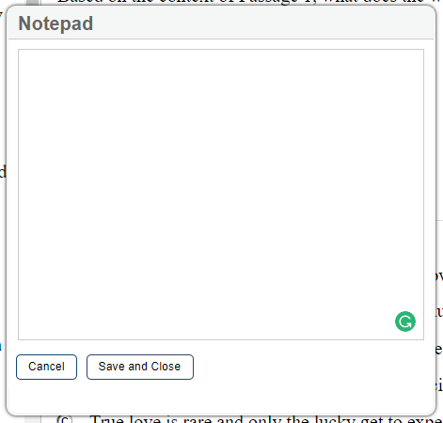
Notepad
Notepad
-First, click on the context menu icon.
-Then, choose ‘Notepad’.
-Next, a blank Notepad will appear.
-Finally, the space can be used to take notes that can be saved and accessed throughout the assessment. Each question has it’s own notepad.

Slide 42
Strikethrough
Strikethrough
-First, click on the context menu icon.
-Then, choose ‘Strikethrough’.
-Finally, click on the answer choices to strike from the list of options.

Slide 43
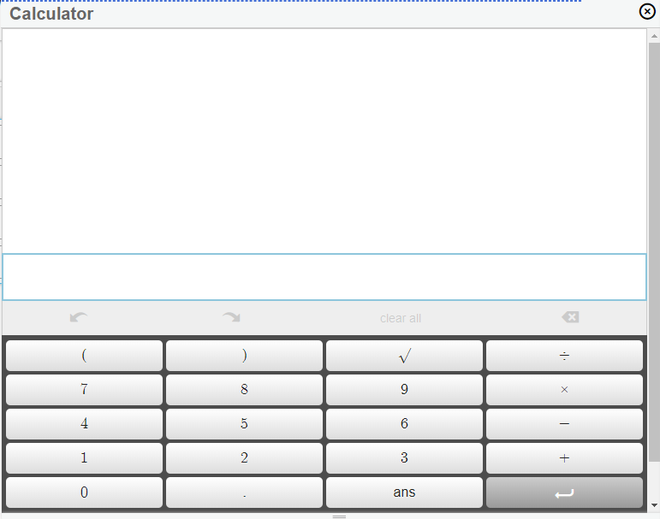
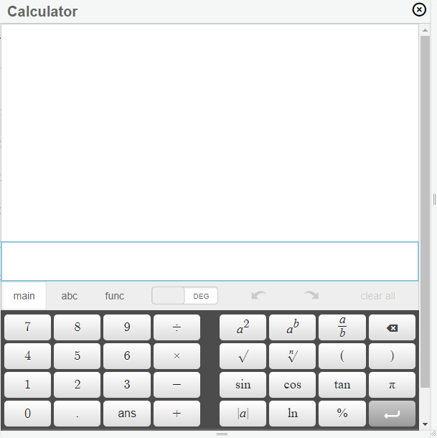
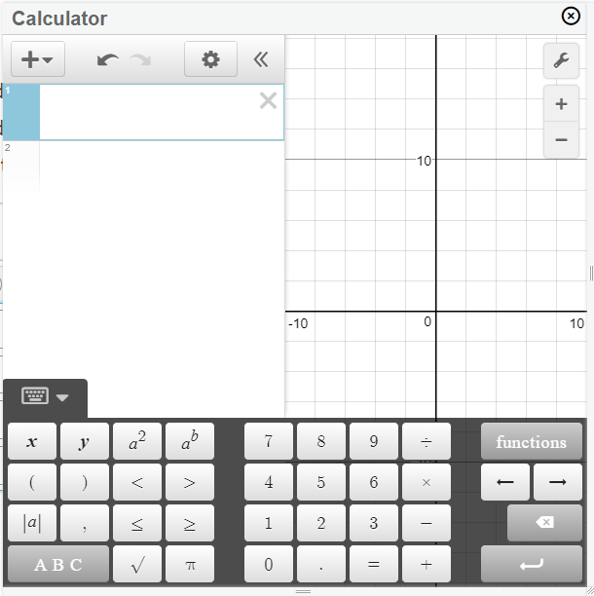
Calculator
Calculator
-First, click on the calculator icon in the top right corner of the screen.
-Then, if needed, move the calculator to a desirable location on the screen.
Grade 6 (Basic)
Grades 7-8 (Scientific)
Grades 9-10 (Graphing)

