Slide 1
Training the Trainers
WDE Forms Training, Day 2

Slide 2
From Good to Great
From Compliance to Outcomes

Slide 3
Capacity building
It is our goal to help district’s build internal capacity to train new staff and refresh existing staff on the use of the WDE model forms.
We will help you develop expertise with the forms, and a resource bank to assist you with the uncertainties in order to be the “GO TO” person in your district.

Slide 4
The challenges
One of the biggest challenges you may face is helping your district’s staff to understand that the best approach is to tell the story of the child, rather than fill in blanks on a form.
If the story of the child is told from beginning to end, then the use of the forms becomes the vehicle for that story.
It is our mission to have educators think less about what goes in the box, and more about documenting the who, what, when, where, and why regarding this child.

Slide 5
The challenges
Another serious challenge will be the lack of one clear answer. What may be appropriate for one student is inappropriate for another student.
Examples are wonderful learning tools, but examples are not THE ANSWER.
Teaching others to generalize the concept rather than the answer is a difficult task.

Slide 6
The authority
Knowing how to understand the sources of authority can be very helpful to refining our knowledge of the law and compliance with it.

Slide 7
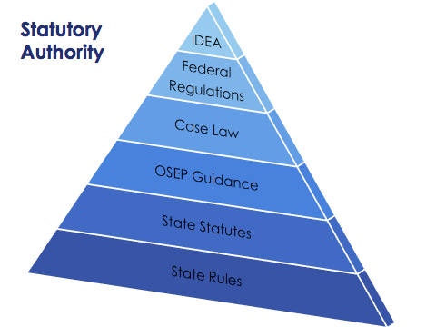

Slide 8
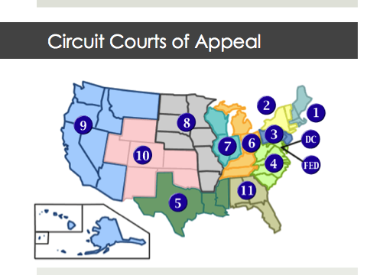

Slide 9
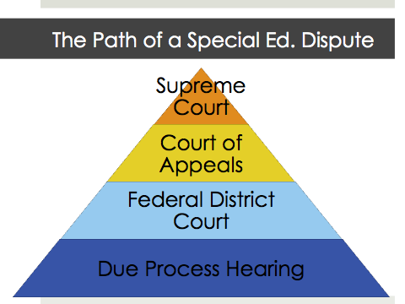

Slide 10
7 topics to galvanize the IEP to improve outcomes

Slide 11
#1 When RTI becomes special education
Using an intervention model prior to the special education referral is now considered the industry standard. It is typically viewed as a regular education activity.
Train staff to recognize when the responsibility shifts from regular education to special education. Here are some triggers:

Slide 12
When RTI becomes special education
When progress cannot be documented;
When progress plateaus, i.e. the child is a nonresponder; and
When a parent requests that the child be evaluated.

Slide 13
OSEP guidance
At any time during the intervention process, if a parent requests a special education evaluation, special education has a role to play.
A team will need to determine whether the school
Suspects that the student is a learner with an IDEA disability, and
Suspects that the student needs special education.
OSEP has provided recent guidance on this topic: Memorandum to State Directors of Special Education, 56 IDELR 50 (OSEP 2011).
Quick Link: OSEP RTI Memo
See the Attachments folder for a copy of the OSEP RTI Memo.

Slide 14
OSEP guidance
The use of RTI does not diminish a district's obligation under the IDEA to obtain parental consent and evaluate a student in a timely manner. When there is reason to suspect the student may have a disability and need special education and related services as a result, the IDEA's initial evaluation provisions kick in, regardless of whether the district plans to or is currently utilizing RTI strategies with the student.

Slide 15
WDE Guidance
In collaboration with stakeholders, WDE developed a guidance document: “A Model Response to Intervention (RtI) Framework to Identify Students with Specific Learning Disabilities.”
The purpose of the document was to establish a common language and understanding about the Wyoming RtI Framework for schools, districts and other stakeholders. The RtI procedures and practices are offered as guidance.
Quick Link: WDE Framework Document
See the Attachments folder for a copy of the RtI Framework Document.

Slide 16
Jackson v. Northwest Local Sch. Dist., 55 IDELR 71 (S.D. Ohio 2010).
The parent of a third-grader with ADHD successfully appealed a district's decision to discipline her child without first conducting an MD review. The district provided the student with interventions starting in first grade. In third grade, her teachers became increasingly concerned about the impact of the student's escalating behavior on her academic performance. The intervention assistance team reconvened and recommended that the student undergo a mental health evaluation, but it did not initiate a special education evaluation at that time.
The following month, the district suspended and expelled the student for threatening behavior. When the parent filed for due process, the district argued that an MD review was not required because the student had not yet been found eligible under the IDEA. When the district expelled the student, it had provided her with intervention services for approximately two years yet she had made few gains.
Additionally, the behavioral concerns expressed by her teacher and others warranted a referral to an outside mental health agency. These circumstances provided "sufficient reason for [the district] to suspect that [the student] might be a child with a disability and, therefore, entitled to an evaluation under the IDEA.”

Slide 17
A.P. v. Woodstock Bd. of Ed., 50 IDELR 275 (D. Conn. 2008).
Because an elementary school student made progress with the use of general education interventions, a district did not err in failing to refer him for a special education evaluation. The District Court, denied the parents' request for tuition reimbursement.
The IDEA's child find requirement applies to students who are suspected of having a qualifying disability and being in need of special education as a result. The student in this case did not fulfill the second requirement. Although the student had some difficulties in the classroom, the evidence showed that he responded well to interventions.
The court pointed out that the student received As, Bs and Cs on his report card, and performed "on goal" on a statewide assessment without any accommodations. Moreover, the teacher had regular contact with the parent about the student's progress. "This is decidedly not a case in which a school turned a blind eye to a child in need."

Slide 18
El Paso Indep. Sch. Dist. v. Richard R., 50 IDELR 256 (W.D. Tex. 2008) vacated in part and affirmed in part, 53 IDELR 275 (5th Cir. 2008).
The IDEA requires districts to evaluate students who are suspected of having disabilities that require special education services. Thus, when a district has reason to believe that a student has a disability, it must evaluate the student within a reasonable time.
The district maintained that it fulfilled its child find obligations by providing interventions recommended by its Student Teacher Assessment Team (STAT). However, the court pointed out that the interventions did not demonstrate positive academic benefits.
Not only did the student continue to struggle in reading, math and science, but he failed the Texas Assessment of Knowledge and Skills test for three years in a row. "Why [the district's] STAT committee would have suggested these measures, knowing that [the student] had undertaken each of these steps in the past three years and that none had helped him achieve passing TAKS scores, simply baffles this court,” The District Court wrote.. By failing to evaluate the student in a timely manner, the district violated its child find obligation.

Slide 19
Other resources
Iris Center
Center on Instruction
National Center on Response to Intervention
RTI Action Network

Slide 20
#2 A Comprehensive evaluation – What does this child need?

Slide 21
Comprehensive evaluation
The scope of an evaluation goes beyond eligibility.
The team must determine: 34 C.F.R. §300.304(b)(1)
Whether the child is (or continues to be) a child with a disability; AND
The content of the child’s IEP.
The child must be assessed in all areas of suspected disability. 34 C.F.R. §300.304(c)(4)
The evaluation must be sufficiently comprehensive to identify all of the child’s special education and related services needs, whether or not commonly linked to the disability category.

Slide 22
Comprehensive evaluation
School districts cannot abdicate their responsibilities under the IDEA. Even if a child's parents have the ability to obtain an evaluation, the district still has a responsibility to evaluate the child in all areas of suspected disability. N.B. v. Hellgate Elem. Sch. Dist., 50 IDELR 241 (9th Cir. 2008).
Quick Link: Hellgate Elementary Case
See the Attachments folder for a copy of the RtI Framework Document.

Slide 23
Evaluation Models
There are different models for conducting a comprehensive evaluation. Remember, every evaluation under the IDEA should look at the whole child in order to plan and carry out the evaluation.

Slide 25
Minnesota Department of Education

Slide 26
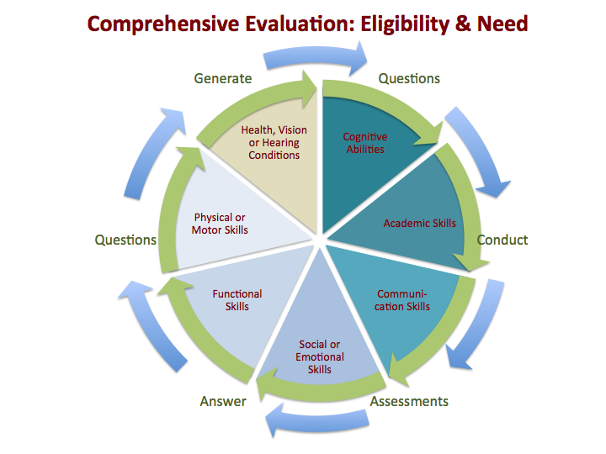

Slide 27
Resources
WDE Reevaluation Reference Guide
OSEP Q & A: IEPs, Evaluations and Reevaluations
WDE Webcast Comprehensive Evaluation and Child Find
Letter to Clarke
See the Attachments folder for a copy of the Reevaluation Reference Guide and Letter to Clarke.

Slide 28
#3 PLAAFP must connect evals, needs, goals, and services

Slide 29
The PLAAFP connection
In order to tell this part of the story, link together evaluation results and current performance across environments and settings with the student’s present needs, measurable annual goals, and services.
Describe where the child is functioning currently, the educational needs, write measurable goals to address the needs, and provide special education and related service to meet those needs.

Slide 30
The PLAAFP Connection
Academic achievement generally refers to a child’s performance in academic areas (e.g., reading or language arts, math, science, and history). We believe the definition could vary depending on a child’s circumstance or situation, and therefore, we do not believe a definition of “academic achievement” should be included in these regulations. 71 Federal Register at 46662.

Slide 31
The PLAAFP Connection
With respect to the meaning of functional performance, the United States Department of Education points to how the term is generally understood as referring to “skills or activities that are not considered academic or related to a child’s academic achievement.” This term “is often used in the context of routine activities of everyday living.” The reason that examples of functional skills were not included in IDEA was because “the range of functional skills is as varied as the individual needs of children with disabilities.” 71 Federal Register at 46661.

Slide 32
The PLAAFP connection
The description of the child's present levels of academic achievement and functional performance must contain sufficient detail to allow the IEP team to determine the extent of the child's abilities and special education needs. See Student with a Disability, 50 IDELR 236 (SEA NY 2008); see also Ashland Sch. Dist., 47 IDELR 82 (SEA OR 2007).

Slide 33
Model PLAAFP
There are many different models for crafting descriptive PLAAFP.
The following slides will illustrate examples.

Slide 34
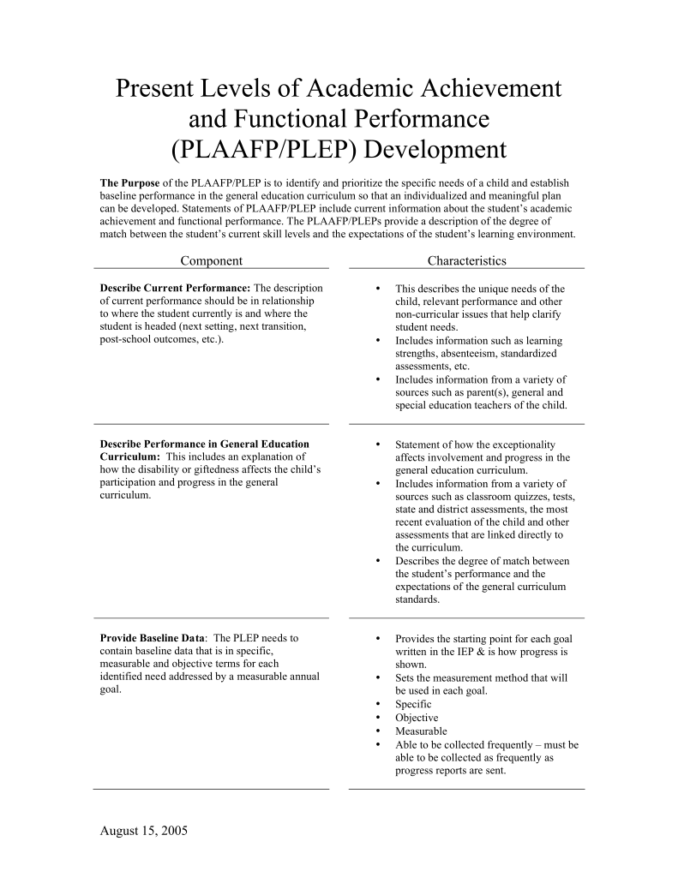

Slide 35
Kansas Department of Education

Slide 36
LINCOLN COUNTY SCHOOL DISTRICT
PLAAFP GUIDANCE
Present Levels starts with a review of most recent evaluation & reports as well as a review of existing data.
Tell Your Story on the child- Include anything else that helps the team understand the student. Please add strengths, islands of competence, positive characteristics and habits as well as weaknesses and concerns. Parent input should be considered.
Statement regarding how disability impacts involvement/participation in Regular Classroom / General Curriculum.
Summary of Key results from all most recent Evaluation Reports. (Note indicated areas of strengths, weakness, and recommendations.) Consider outside evaluations and historical evaluations when appropriate.
Related Service Narrative if applicable.
Most Current District / State Assessment Results (PAWS, CA’s, MAP, other).
Classroom performance (CBA’s, grades, attendance, assignments, homework, other).
Functional Performance. The student’s Social, Emotional, Physical, Health, Advocacy and Independence, organizational, behavioral, and/or non-academic skills or activities.
Progress towards goals of “current / ending” IEP being replaced/revised.
List the areas of need the team considered. Services are based on need. Explain how your priorities will be addressed. Explain areas targeted in past evaluations or IEP’s that are no longer a concern.
Statement that justifies accommodations / modifications. Include current AT use or potential need.
Summary of Post Secondary Transition Activities for students with PS IEP.

Slide 37
LINCOLN COUNTY SCHOOL DISTRICT
PLAAFP GUIDANCE
CONSIDERATIONS
Present levels must align with proposed goals/accommodations/services.
Collaboration is essential for developing an appropriate present level section.
PLAAFP’s should be individualized by describing the child with specificity across environments and up to the moment. They should be a culmination of past and present performance.
All information must be supported with data or a clear description of observations and presented in parent friendly language.
Teams must consider all relevant domains of need across all settings.
The baseline for the proposed goals should be stated on the Goal page(s).

Slide 38
Resources
WDE Webcast PLAAFP and Measurable Goals
Examples of Present Levels
See the Attachments folder for a copy of the Examples of Present Levels.

Slide 39
#4 Goals must be measurable, i.e. quantifiable

Slide 40
Measurable goals
An IEP must include a statement of measurable annual goals, including academic and functional goals designed to –
Meet the child's needs that result from the child's disability to enable the child to be involved in and make progress in the general education curriculum; and
Meet each of the child's other educational needs that result from the child's disability.
34 C.F.R. §300.320(a)(2).

Slide 41
Measurable goals
SMART goals:
Specific
Measurable
Achievable
Results oriented & relevant
Time bound

Slide 42
THE STRANGER TEST
The Stranger Test refers to goals and objectives for students that are described in a fashion that a person unfamiliar with the student could read the description and understand it.
Because various persons involved in the implementation of a student's educational plan may interpret a construct differently, it is necessary to describe student behavior in terms that would pass the Stranger Test.

Slide 43
Measurable goals
Measurable goals must have sufficiently objective criteria for measuring progress. Kuszerski v. Chippewa Valley Schs., 38 IDELR 63 (6th Cir. 2003).
Measurable goals lead to measuring progress.

Slide 44
FAPE PIE
Progress
Reporting
PLAAFP
Specialized
Instruction
LRE
IEP Goals
Related
Service
ESY
Supplementary
Aids and
Service
Special Considerations
Accommodations
and
Modifications

Slide 45
The Rowley Standard
In Rowley, the Supreme Court held that a student's ability to earn passing marks and advance from grade to grade is a strong indicator that he received a meaningful educational benefit.
Rowley addressed the student’s performance in the general education classroom.
Board of Education of the Hendrick Hudson Central School District v. Rowley, 553 IDELR 656 (U.S. 1982).

Slide 46
Progress vs. Mastery
A student's inability to perform at grade level does not indicate a denial of FAPE when a child makes progress commensurate with her abilities.
Walczak v. Florida Union Free Sch. Dist., 27 IDELR 1135 (2nd Cir. 1998).
Similarly, a student's failure to meet his IEP goals does not establish a denial of FAPE when the student is making progress toward his goals.
Schroll v. Board of Educ. Champaign Community Unit Sch. Dist. #4, 48 IDELR 155 (C.D. Ill. 2007).
38

Slide 47
If Progress means educational benefit,
What does a lack of progress mean?
If a student fails to make progress within a reasonable period of time, the district must convene an IEP meeting to address the student's lack of progress. A district's continuation of inadequate services will almost certainly be regarded as a denial of FAPE.
District of Columbia Pub. Schs., 49 IDELR 267 (D.D.C. 2008).

Slide 48
Lack of progress: procedural steps
Review the IEP and confirm implementation.
Reconvene the IEP team to review the lack of expected progress,
Revise the IEP by agreement, if appropriate.
Recalibrate instructional practices to match changes.
Measure Progress.

Slide 49
Lack of progress: substantive considerations
Your efforts must be evidence based and well documented!
Documentation must evidence meaningful educational benefit, or support the teams effort to implement the 4 Rs: RECONVENE, REVIEW, RESTRATEGIZE, AND REVISE!

Slide 50
Are good grades enough?
Achievement of passing grades and advancing from grade to grade in a regular classroom environment is not necessarily an indication that the student is receiving FAPE under the IDEA.
An evaluation of the student's circumstances as a whole is still required.
Hall v. Vance County Board of Education, 557 IDELR 155 (4th Cir. 1985).

Slide 51
Good grades
When high grades are achieved in classes with only special education students set apart from the regular classes of a public school system, the grades are of less significance than grades obtained in regular classrooms.”
“Overall, we think that it is clear that a court should not place conclusive significance on special education classroom scores, a conclusion that we believe is reinforced by the circumstance that, as here, there may be a disconnect between a school's assessment of a student in a special education setting and his achievements in that setting and the student's achievements in standardized testing.”
“When there is such a disconnect we think that there should be an especially close examination of the appropriateness of the student‘s education.
D.S. and A.S. v. Bayonne Bd. of Educ., 54 IDELR 141 (3rd Cir. 2010).

Slide 52
Failing grades
Just as passing grades do not always establish the provision of FAPE, failing grades do not always indicate a denial of FAPE. The amount of appropriate regular education progress, in terms of passing grades and grade-to-grade advancement, necessarily depends upon the abilities of each individual student with a disability.
Carter v. Florence County Sch. Dist. 4, 18 IDELR 350 (4th Cir. 1991), aff'd, 20 IDELR 532 (U.S. 1993).
Some children, due to the extent of their disabilities, will never be able to perform at grade level and will require several years to achieve what would be to a nondisabled child a year's worth of progress.
Conklin v. Anne Arundel County Bd. of Educ., 18 IDELR 197 (4th Cir. 1991).

Slide 53
Remember the 4 Rs
RECONVENE,
REVIEW,
RESTRATEGIZE, AND
REVISE!

Slide 54
Resources
OSEP Q & A: IEPs
All About the IEP

Slide 55
#5 LRE – General education first!
The IDEA presumes that the first placement option considered for each child with a disability is the regular classroom in the school that the child would attend if not disabled, with appropriate supplementary aids and services to facilitate such placement.
Therefore, before a child with a disability can be placed outside of the regular education environment, the full range of supplementary aids and services that could be provided to facilitate the child’s placement in the regular classroom setting must be considered.
71 Federal Register 46588.

Slide 56
LRE
Least restrictive environment, or LRE as it is more commonly called, is one of several vital components in the development of a child’s IEP and plays a critical role, influencing where a child spends his or her time at school, how services are provided, and the relationships the child develops within the school and community. Indeed, LRE is a foundational element in building an appropriate IEP that can improve outcomes for a child—in school and in life.
Considering LRE in Placement Decisions, NICHCY.

Slide 57
B.S. v. Placentia-Yorba Linda Unified Sch. Dist., 51 IDELR 237 (9th Cir. 2009).
Because a student with autism would receive little benefit from a general education language arts class, a district did not err in recommending a special education placement for language arts instruction.
The 9th Circuit affirmed a ruling that the district offered the student FAPE in the LRE. The court acknowledged that the IDEA expresses a strong preference for mainstreaming, but explained that a district's primary duty is to ensure that students with disabilities receive FAPE.
"We noted nearly 25 years ago that mainstreaming 'is a policy which must be balanced with the primary objective of providing [students with disabilities] with an appropriate education.'"

Slide 58
Letter to Trigg, 50 IDELR 48 (OSEP 2007).
The overriding rule is that placement decisions must be determined on an individual, case-by-case basis, depending on the child’s unique needs and circumstances, and based on the child’s IEP.
In all cases, however, placement decisions must not be based on factors such as category of disability, severity of disability, availability of special education and related services, configuration of the service delivery system, availability of space, or administrative convenience.
Quick Link: Letter to Trigg
See the Attachments folder for a copy of Letter to Trigg.

Slide 59
A.G. V. Wissahickon Sch. Dist., 54 IDELR 113 (3rd Cir. 2010).
A district complied with the LRE mandate when it placed a student with mental retardation in only one academic class with regular education peers, the 3rd Circuit Court held.
Although her mother wanted the teenager to spend the entire school day with nondisabled peers, such a placement was inappropriate given the student's cognitive deficits and disruptive behavior.
The district initially placed the student, a nonverbal 18-year-old, in a life skills class with mainstreaming for assemblies, lunch, homeroom, gym, and recess. The parent alleged the district violated the LRE mandate.
The IDEA requires districts to educate children with disabilities with nondisabled peers to the "maximum extent appropriate." 34 CFR 300.114(b). In this case, the student could not be satisfactorily educated full-time in a regular class, even with accommodations, the 3rd Circuit reasoned.

Slide 60
LRE
"While including students in the regular classroom as much as is practicable is undoubtedly a central goal of the IDEA, schools must attempt to achieve that goal in light of the equally important objective of providing an education appropriately tailored to each student's particular needs.” P. v. Newington Bd. of Educ., 51 IDELR 2 (2nd Cir. 2008).

Slide 61
When is LRE considered?
Once the IEP team has decided what services a child needs, a decision must be made about where services will be provided. Where the child’s IEP is carried out is called placement.
Parents have the right to be part of the group that decides the child’s placement.
In deciding the child’s placement, the group must make sure that the child has the maximum opportunity appropriate to learn with children who do not have disabilities—in academic, nonacademic, and extracurricular activities. This part of IDEA is called Least Restrictive Environment or LRE.
NICHCY 2010.

Slide 62
Resources
Considering LRE in Placement Decisions
WDE Reference Guide: LRE
See the Attachments folder for a copy of the WDE Reference Guide: LRE.

Slide 63
#6 FAPE and ESY

Slide 64
FAPE and ESY
"Multifactor" approach.
Eligibility for ESY programming, however, should not be based solely upon regression-recoupment analysis. In Johnson v. Independent Sch. Dist. No. 4 of Bixby, 17 IDELR 170 (10th Cir. 1990), the court identified the following factors that may need to be considered in this analysis:

Slide 65
FAPE and ESY: The 10th Circuit Factors
Degree of regression suffered in the past.
Exact time of past regression.
Ability of parents to provide educational structure at home.
Child's rate of progress.
Child's behavioral and physical problems.
Availability of alternative resources.
Ability of child to interact with nondisabled children.
Areas of child's curriculum that need continuous attention.
Child's vocational needs.
Whether requested services are extraordinary for the child's condition, as opposed to an integral part of a program for populations of students with the same disabling condition.

Slide 66
FAPE and ESY
Significantly, the ED recognizes that a student's ESY placement may differ from his regular school year placement. Because the purpose of ESY services is typically to prevent regression and recoupment problems, a student's placement for ESY services may differ from his placement during the school year.
A full continuum of services is not required for ESY. Letter to Myers, 16 IDELR 290 (OSEP 1989).

Slide 67
FAPE and ESY
Districts must maintain placement options for ESY services that are necessary to implement the student's IEP and to meet the requirements of LRE. Thus, even though Part B of the IDEA does not address the district's obligation to provide a full range of alternative placements, the district must meet the LRE requirement by alternative means, such as private placements, if it is decided that disabled children must have interaction with nondisabled children. Letter to Myers, 213 IDELR 255 (OSEP 1989).

Slide 68
Good questions (adapted from the Michigan Department of Education)
Is there one or more current annual goal(s) that address skills which need to be maintained without interruption for the student to benefit meaningfully from a FAPE?
There must be at least one current IEP goal where significant concerns exist regarding skill maintenance during a break in services. Goal areas of concern should represent skills essential to the progress of the student.
The determination of the need for ESY services must be based on data. The IEP team needs to evaluate the data to determine which, if any, goals represent areas of concern that may present significant difficulties in maintaining skills during breaks.
If no, ESY is not needed for a FAPE.

Slide 69
Good questions
If yes, for each goal area of concern, answer the following questions:
Is there information that indicates to the IEP team that in this goal area there is a serious potential for regression of skills beyond a reasonable period of recoupment? What data support this?
Is there information regarding the nature or severity of disability of the student that indicates to the IEP team that there is a need to provide services in the identified goal area of concern during breaks in the school year? What data support this?

Slide 70
Good questions
Is there information that indicates to the IEP team that in the identified goal area of concern the student is at a critical stage of learning or in a critical area of learning where failure to provide a service beyond the normal school year or school day will severely limit the student’s capacity to maintain essential skills?
Is there a skill that needs to be mastered immediately? If the student does not master the skill immediately, is the degree of mastery likely to be permanently reduced? What data support this?
Is the student at a critical stage of development where there is a window of opportunity that will be lost if services are not provided? What data support this?
Are there changes in the student’s medical, physical, or sensory status that makes it possible to predict an accelerated rate of learning during the ESY period (critical stage)? What data support this?
Is the skill in a critical area of learning and will a break in services result in the loss of a window of opportunity for mastering the skill? What data support this?

Slide 71
Resources
WDE Webcast: ESY and AT
Johnson v. Bixby
See the Attachments folder for a copy of the Johnson v. Bixby 10th Circuit Case.

Slide 72
#7 Don’t underestimate transition’s role
The IEP must provide special education students with a customized roadmap, i.e. a transition plan, for meeting their postsecondary goals.

Slide 73
Measurable Post Secondary Goals
Measurable postsecondary goals are specific to the areas of training/education, employment and independent living, and where appropriate, may be written into a single “combo” goal that addresses training/education and, where appropriate, independent living in a single goal or as separate goals.
UPDATE: OSEP has recently released guidance on transition. According to OSEP, training and education goals SHOULD NOT be combined with employment goals. Quick Link: OSEP Q & A on Secondary Transition
Quick Link:Kansas Department of Education Transition Resources

Slide 74
Measurable Post Secondary Goals (adapted from the Kansas Dep’t of Ed. website)
Employment:
After graduation, James will be employed as a Diesel Mechanic.
Education/Training:
After graduation, James will attend Kaw Valley’s Technical Institute’s 2 Year Diesel course.

Slide 75
Measurable Post Secondary Goals (adapted from the Kansas Dep’t of Ed. website)
Training/Education:
After high school, I/David will get on the job training to become a farmer.
Employment:
After high school, I/David will work full time as a farmer.

Slide 76
Measurable Post Secondary Goals (adapted from the Kansas Dep’t of Ed. website)
Training/Education:
After high school, Eric will get on the job training in an area related to dirt bike racing.
Employment:
After high school, Eric will work full time with dirt bikes. Independent Living: After high school, Eric will live in an apartment with friends.

Slide 77
Measurable Post Secondary Goals (adapted from the Kansas Dep’t of Ed. website)
Training/Education:
After high school, Sheila will enroll full time at KU in the nursing program.
Employment:
After high school, Sheila will work full time as a nurse.

Slide 78
Measurable Post Secondary Goals (adapted from the Kansas Dep’t of Ed. website)
Training/Education:
After completion of school, I /Lance will attend the XYZ Center and receive training on work behaviors and skills.
Employment:
After completion of school, I/ Lance will be employed in a sheltered environment at the XYZ Center.
Independent Living:
After completion of school, I/ Lance will live with my mother and continue to take part in community activities like bowling, going to church and visiting friends and family.

Slide 79
Summary of Performance
The connection between transition IEPs and the end of the story is made with the Summary of Performance.
It is the last opportunity to provide a transitioning student with recommendations to take with them.

Slide 80
Summary of Performance
IDEA 2004 added a new requirement for students with disabilities called the Summary of Performance (SOP). A summary of the student’s academic achievement and functional performance including recommendations on how to assist the child in meeting their postsecondary goals must be given to a student whose eligibility under special education terminates due to graduation with a regular diploma, or due to exceeding the age of eligibility. A SOP is not required for students exiting special education services by completion of goals, dropping out (not graduating or aging out) or is identified only as Gifted.

Slide 81
Summary of Performance
The purpose of the Summary of Performance is to transfer critical information that leads to the student’s successful participation in postsecondary settings. The SOP must be completed during the final year of the student’s high school education, though time of completion may vary with student’s desired postsecondary goals. The development of the SOP may be started at any time, however, it is recommended to begin development of the SOP during the freshman year.

Slide 82
OSEP Guidance
Question: Does a general educational development credential (GED) or alternate diploma trigger the creation of an SOP? Answer: No. A public agency, pursuant to 34 CFR §300.305(e)(3), must provide a child whose eligibility for services under Part B of the IDEA terminates due to graduation from secondary school with a regular diploma, or due to exceeding the age of eligibility for a free appropriate public education (FAPE) under State law, with a summary of the child's academic achievement and functional performance. This Part B requirement does not apply to the group of children who leave secondary school with a GED credential or alternate diploma and whose eligibility for services under Part B has not terminated. See 34 C.F.R. §300.102(a)(3)(iv), which clarifies that a regular high school diploma does not include alternate degrees, such as a GED credential.
Quick Link: OSEP Q & A on Secondary Transition

Slide 83
Summary of Performance (SOP) Frequently Asked Questions (adapted from the Connecticut Dep’t. of Ed.
1. Should the student receive a copy of the Summary of Performance (SOP)?
Yes. According to 34 CFR §300.305(e)(3) – “ . . . the public agency must provide the child with a summary of the child’s academic achievement and functional performance, which shall include recommendations on how to assist the child in meeting the child’s postsecondary goals.”
2. Should the parent of a student who is 18 years or older receive a copy of the SOP?
The parent of a student who is 18 years or older should receive a copy of the SOP only if the student has provided written permission for the parents to get a copy of IEP/PPT records. Specify SOP on the release form since it is not a formal part of the IEP. Best practice would suggest that it would be helpful for most students if the parent(s) also received a copy of the SOP.

Slide 84
SOP Frequently Asked Questions
3. If the student is at a level of functioning at which he/she would not readily understand the SOP, could it be given to the parent(s)?
Yes. Although IDEA does not require that a copy of the SOP be given to the parent(s), best practice would indicate that the parent(s) should also receive a copy in addition to the student or instead of the student if he/she would not be able to understand it. However, if the student has reached the age of majority under State law (i.e., 18), he/she would have to give written consent if the parents were not the individual(s) appointed to represent the educational interests of the child.
4. Should the SOP be reviewed (face-to-face) with the student/parent?
Best practice indicates that to the extent possible, the SOP should be reviewed with the student (and parents when appropriate) in a face-to-face informal meeting or conversation. A formal PPT meeting does not need to be initiated to review the SOP.

Slide 85
SOP Frequently Asked Questions
5. If the student is not available to meet to receive the SOP, can it be mailed to him/her? (e.g., home bound student, student who was expelled but completed graduation requirements at home with a tutor).
Although mailing the SOP to a student meets the requirements of IDEA, it would be preferable that district personnel make every effort to discuss it with a student - preferably in person (in school or home) or at the very least, over the phone with the student looking at a copy.
6. It is understood that "exiters" consists of graduates and students aging out. What about students who drop out, or who are old enough to "sign themselves out" and transfer directly to finish at Adult Education? Does an SOP need to be completed for these students?
A student who drops out or signs out before graduation or turning 22 (with or without warning) would not need to have an SOP.

Slide 86
GUIDING PRINCIPLES FOR TRANSITION PLAN DEVELOPMENT By T.E. Smith, B.C.; Gartin, N.L.; and Murdick, A. Hilton
1. Transition efforts should start early and continue until transition occurs. Schools should take a proactive approach to transition. Transition efforts should begin at age 14* and not wait until a student is nearing the end of public school.
2. Planning must be comprehensive. A district must focus on more than just school to post-school environments and services and develop a plan that encompasses transition needs from first grade through high school and provides supports for all students with special needs.

Slide 87
GUIDING PRINCIPLES FOR TRANSITION PLAN DEVELOPMENT By T.E. Smith, B.C.; Gartin, N.L.; and Murdick, A. Hilton
3. The planning process must balance what is ideal with what is possible. Even though it is important for students with special needs, their family members, and school staff to dream about adult opportunities, reality must be a factor in developing and implementing transition plans.
4. Student participation is essential. The one person most affected by transitions is the student with special needs so students and their family members must be involved in the entire process in order to incorporate their dreams, wishes, and ideas.

Slide 88
GUIDING PRINCIPLES FOR TRANSITION PLAN DEVELOPMENT By T.E. Smith, B.C.; Gartin, N.L.; and Murdick, A. Hilton
5. Family involvement is crucial. Family involvement in the transition planning and implementation process is vitally important because family members have information to contribute related to the future of their child.
6. The transition planning process must be sensitive to diversity. Diversity among students and their families must be taken into consideration when developing a transition plan because different cultures expect and desire different outcomes from school.

Slide 89
GUIDING PRINCIPLES FOR TRANSITION PLAN DEVELOPMENT By T.E. Smith, B.C.; Gartin, N.L.; and Murdick, A. Hilton
7. Everyone uses supports and services. All individuals who make changes need supports during transitions but students with special needs may need more extensive supports.
8. Community-based activities are important. Including community-based teaching and training opportunities is an excellent means of easing transition difficulties.
9. Interagency commitment, cooperation, and coordination must be improved. Without the active involvement of all agencies involved in providing services to children and their families, important transition efforts may be overlooked.

Slide 90
GUIDING PRINCIPLES FOR TRANSITION PLAN DEVELOPMENT By T.E. Smith, B.C.; Gartin, N.L.; and Murdick, A. Hilton
10. Timing is crucial if linkages are to be made and a seamless transition to life after high school is to be achieved. Waiting until students have difficulties is too late to provide appropriate support services.
11. The transition planning process should be considered a capacity-building activity.
12. Ranking of transition needs must occur. Part of the transition planning process should be to rank order the transition needs of students.
13. Transition planning is beneficial to all students. Preparing for change is a good way of avoiding pitfalls that often occur when there are changes.

Slide 91
What if transition services are deficient?
If a student has not received adequate transition services prior to graduation, case law clearly supports the view that the district would be vulnerable to a compensatory education award for the student, or even rescission of the diploma. See Lessard v. Wilton-Lyndeborough Cooperative School District, 49 IDELR 180 (1st Cir. 2008) and East Hartford Board of Education, 50 IDELR 240 (SEA Conn. 2008). The burden is on an individual parent to challenge a student’s graduation or denial of FAPE in individual cases.
If a student has not received adequate transition services prior to graduation, but receives a regular diploma, the appropriate remedy would likely be compensatory education. See Dracut Sch. Committee v. Bureau of Sp. Ed. Appeals, 55 IDELR 66 (D. Mass. 2010).

Slide 92
Resources
National Secondary Transition Technical Assistance Center
Learning Disabilities Association Model Summary of Performance Form
Guiding Principles for Transition Plan Development
Utah Transtion Action Guide
Transition coalition
Summary of Performance FAQ
See the Attachments folder for a copy of Utah’s Transition Action Guide and the SOP FAQ.

Slide 93
Remember. . .
Remember, the 7 steps to galvanize your IEP have been identified to help districts achieve procedural and substantive compliance, but most importantly, improve outcomes for students with disabilities.
The resources listed at the end of each section are “hot” links to other helpful tools.
In combination, these resources are intended to help districts build internal capacity to maintain compliance and improve outcomes for students.

Slide 94
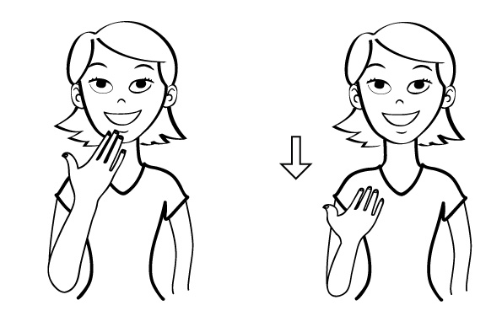
Thank you!

