Slide 1

"Seek the wisdom of the ages, but look at the world through the eyes of a child."
Ron Wild
Program Assessment-Formative and Summative

Slide 2

Purposes of Program Assessment
Measure overall progress toward goals and objectives.
Measure effectiveness of activities or programs for particular groups of students/youth
Measure incremental progress toward particular objectives.
Measure changes in the program over time.

Slide 3



21stCCLC Framework

Slide 4

Federal Reporting
Profile and Performance Information Collection System (PPICS)
Input: Student attendance, demographics, center staffing, cumulative teacher survey data, cumulative assessment data, individual activity information all reported by center for each cohort
Output: Full APR report by Cohort, 6 other reports comparing subgrantee data, and over 30 detail reports available at the center level
Who Uses the Data Reports: US Dept of Education, Wyoming Department of Education, local programs, general public (public reports at subgrantee and state level only)

Slide 5
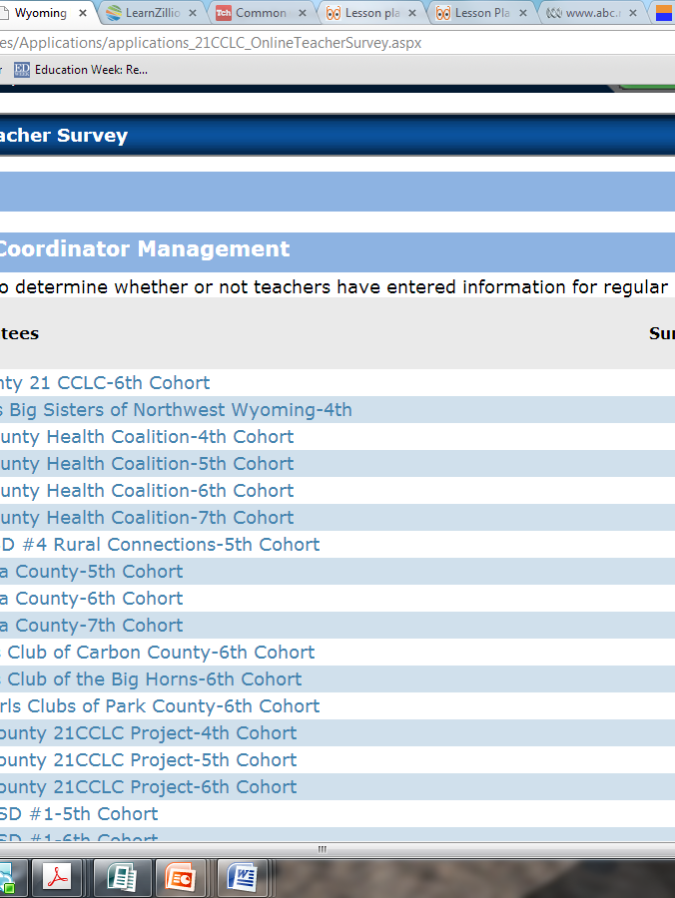
Fusion Data System
Input: WISERids, attendance and teacher survey data
Output: Annual Report for each Cohort with population served demographic information, disaggregated academic achievement information for MAP and PAWS (also .DIBELS, if entered into Fusion), and growth data from the previous year, summary of teacher survey, and data “highlights”
Who Uses the Data Reports?- Wyoming Department of Education, local programs

Slide 6

Required Local Evaluation
Information provided to WDE yearly in renewal applications or closeout reports.
Positives-Allows individualized approach to evaluation
Challenges- paper-based so difficult to aggregate data, no standard for quality, no evidence required that data was used for improvement

Slide 7

Moving Forward With Local Evaluation
Potential Strategies
Require all subgrantees to use the same tools for summative evaluation but not for formative evaluation processes.
Require all subgrantees to use the same tools for formative processes and summative evaluation.
Contract with a provider to design and carry out a local evaluation process to be used for all subgrantees using currently collected data and additional local quality data.
Other ideas…..

Slide 8
Brainstorming Session
Using the Program Evaluation Summary as a starting point, please discuss in your group what an ideal local evaluation would look like. Describe what you need to communicate with staff to reach goals (measured throughout the year) and what you need to communicate with boards, community groups and future funders. Please include specifics about format of the data, analysis information, etc.

