Slide 1
Welcome!
2015 Wyoming Homeless Education Workshop

Slide 2
Thank you!
Campbell County School District #1
Goshen County School District #1
Laramie County School District #1
Natrona County School District #1
Park County School District #1
Sheridan County School District #1

Slide 3
Thank you!
National Center for Homeless Education
National Association for the Education of Homeless Children and Youth
Florida Department of Education
Michigan Department of Education
Montana Office of Public Instruction

Slide 4
Thank you!
Laramie County Community College
Little America Hotel
Laramie County Community Partnership, Strong Families Action Team
Wyoming Homeless Collaborative

Slide 5
Thank you!
Office of Governor Matt Mead
Wyoming Department of Family Services
Wyoming Head Start Collaboration Office
WDE, Communications Team
WDE, Special Programs Division
WDE, Trina Whitley and Gina Lujan

Slide 6
Housekeeping
Agenda
Post-Its/Question Chart
Restrooms

Slide 8
Wyoming by the Numbers
Notes:
From Wyoming Head Start Program Information Report 2013
Nationally the number of homeless children served by Head Start doubled between 2007 and 2012
An 81% increase in just two years
90% between 2012 and 2013

Slide 9
Wyoming by the Numbers
Notes:
66% of Wyoming school districts have had monitoring findings for not using the correct federal definition the last two years.
28 Wyoming districts were flagged by the U.S. Department of Education for failure to accurately identify homeless districts in the 2012-2013 school year.

Slide 10
Wyoming by the Numbers
Notes:
Wyoming is a minimally funded state.
Wyoming awards about $112,000 in competitive grants to districts each year.
Only 10% of Wyoming districts received grants in the last cycle.

Slide 11
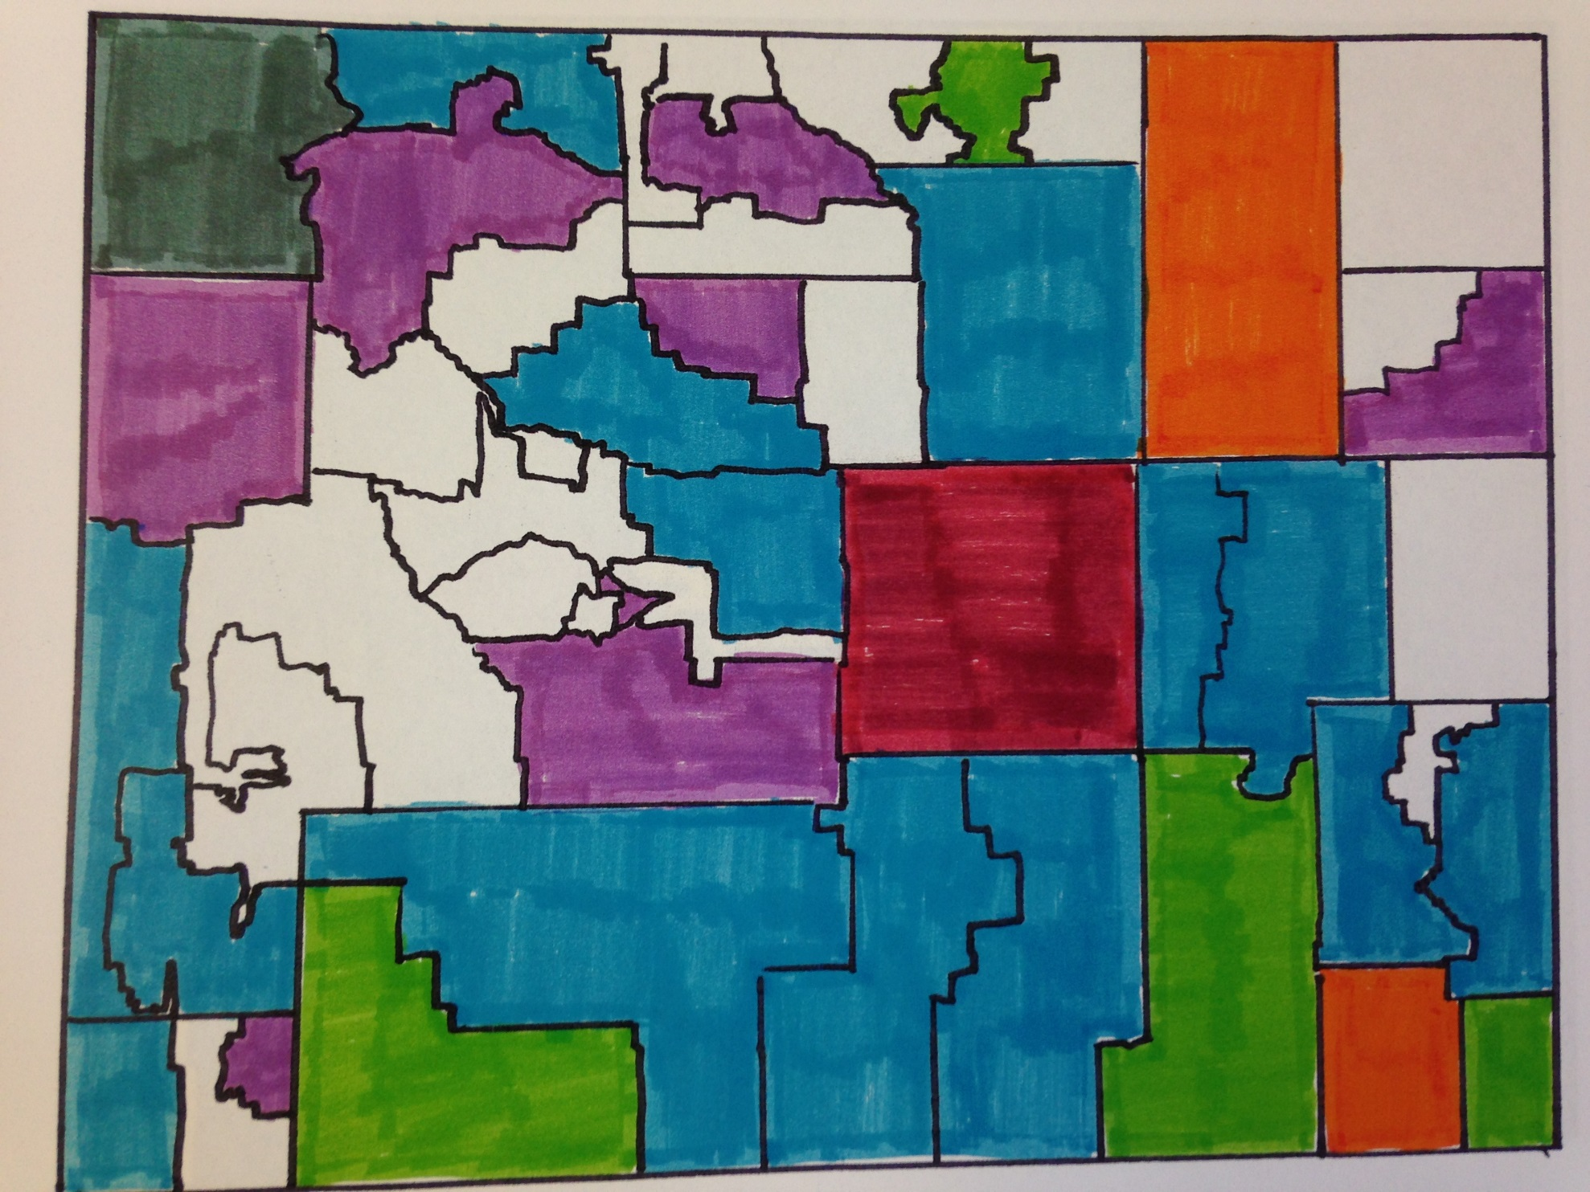

Slide 12
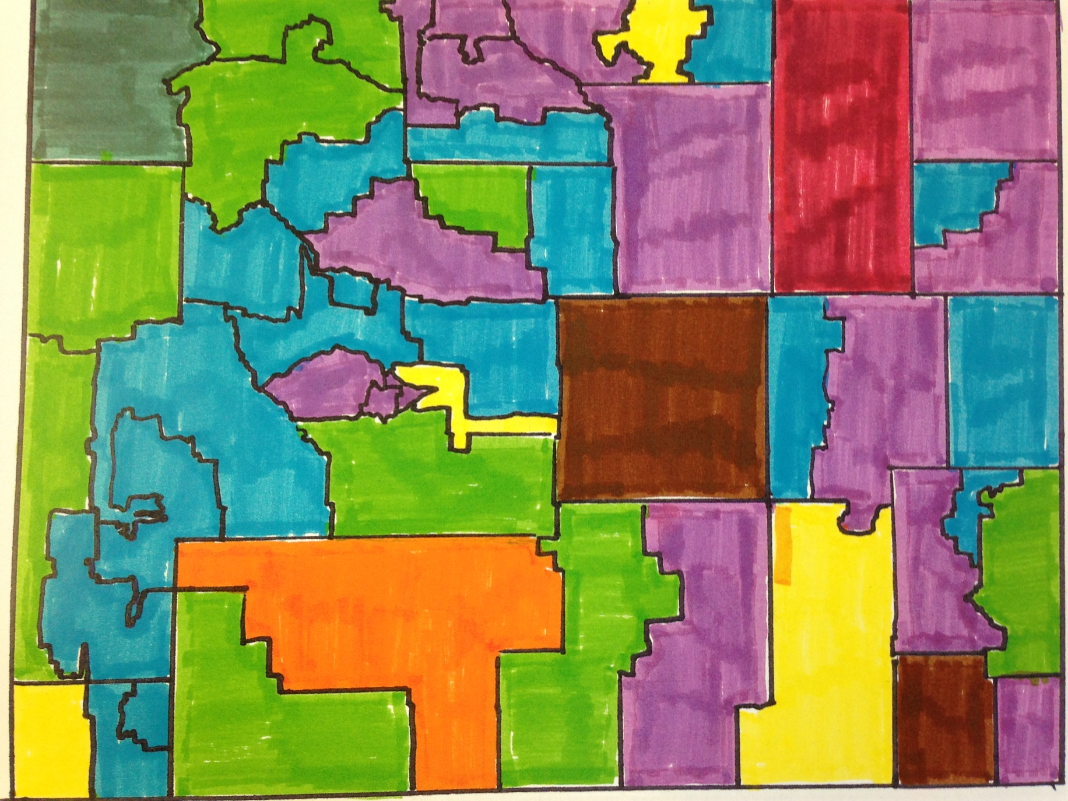

Slide 13
SY 2015-2016 Goals
Continue to increase awareness of youth homelessness throughout Wyoming
Build on collaboration opportunities
Establish a higher education network for youth experiencing homelessness in Wyoming
Launch capacity-building mini-grants for school districts
Launch a new WDE homeless education webpage
Begin a revamped competitive grant process for Wyoming school districts

Slide 14
Candy Budget

