Slide 1
NAEP-TIMSS Linking Study
In 2011, both NAEP and TIMSS assessed grade 8 students in Mathematics and Science
2011provided an opportunity to examine the linkage between the two assessments
Attempt to connect the scales so as to estimate the performance on one scale from the other

Slide 2
NAEP-TIMSS Linking Study
Challenges in any attempted linking
Differences in populations
Exclusion rates varied on NAEP and TIMSS
TIMSS offers no accommodations
Differences in assessment
NAEP offers fewer short-constructed response items
TIMSS offers no extended-constructed response items
NAEP window prior to TIMSS window
Different timing and subject structure

Slide 3
NAEP-TIMSS Linking Study

Slide 5
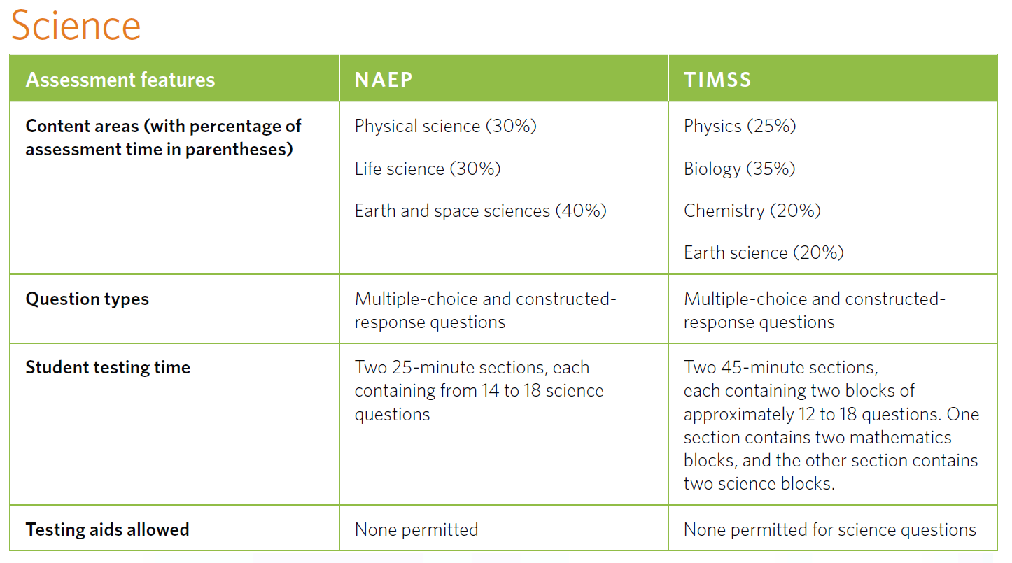

Slide 6
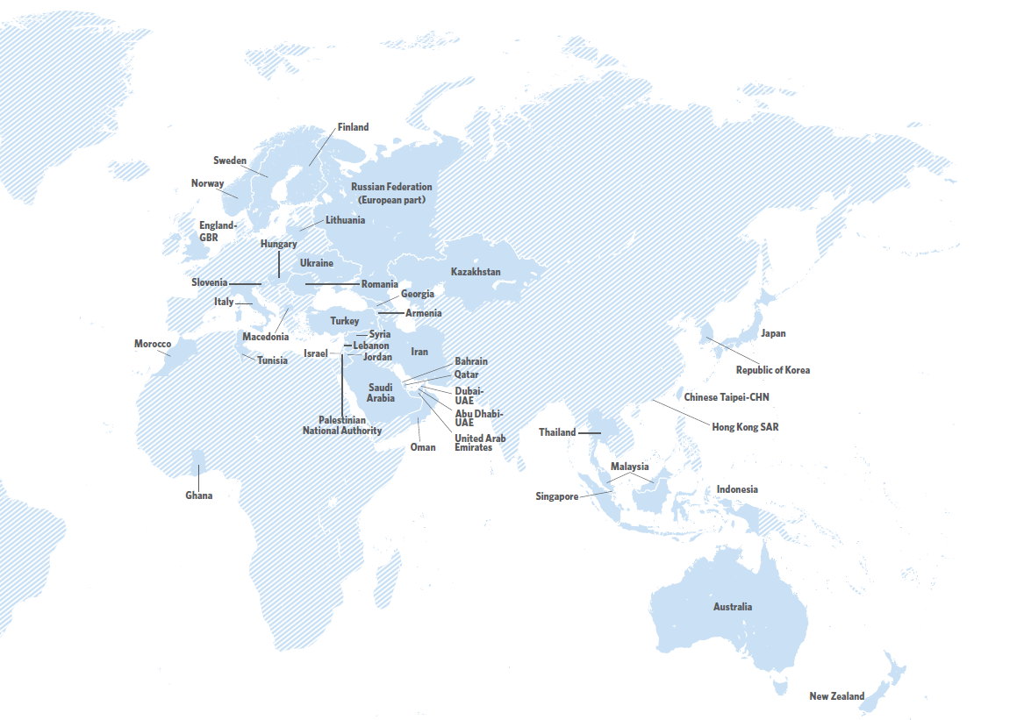
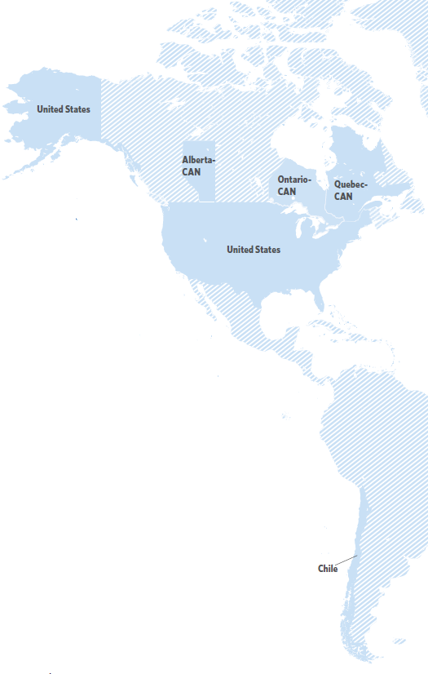
TIMSS 2011, N=47

Slide 7
NAEP-TIMSS Linking Study
In 2011, nine states participated in TIMSS as “education systems” and received actual TIMSS results
Alabama, California, Colorado, Connecticut, Florida, Indiana, Massachusetts, Minnesota, North Carolina
TIMSS results released December 11, 2012

Slide 8
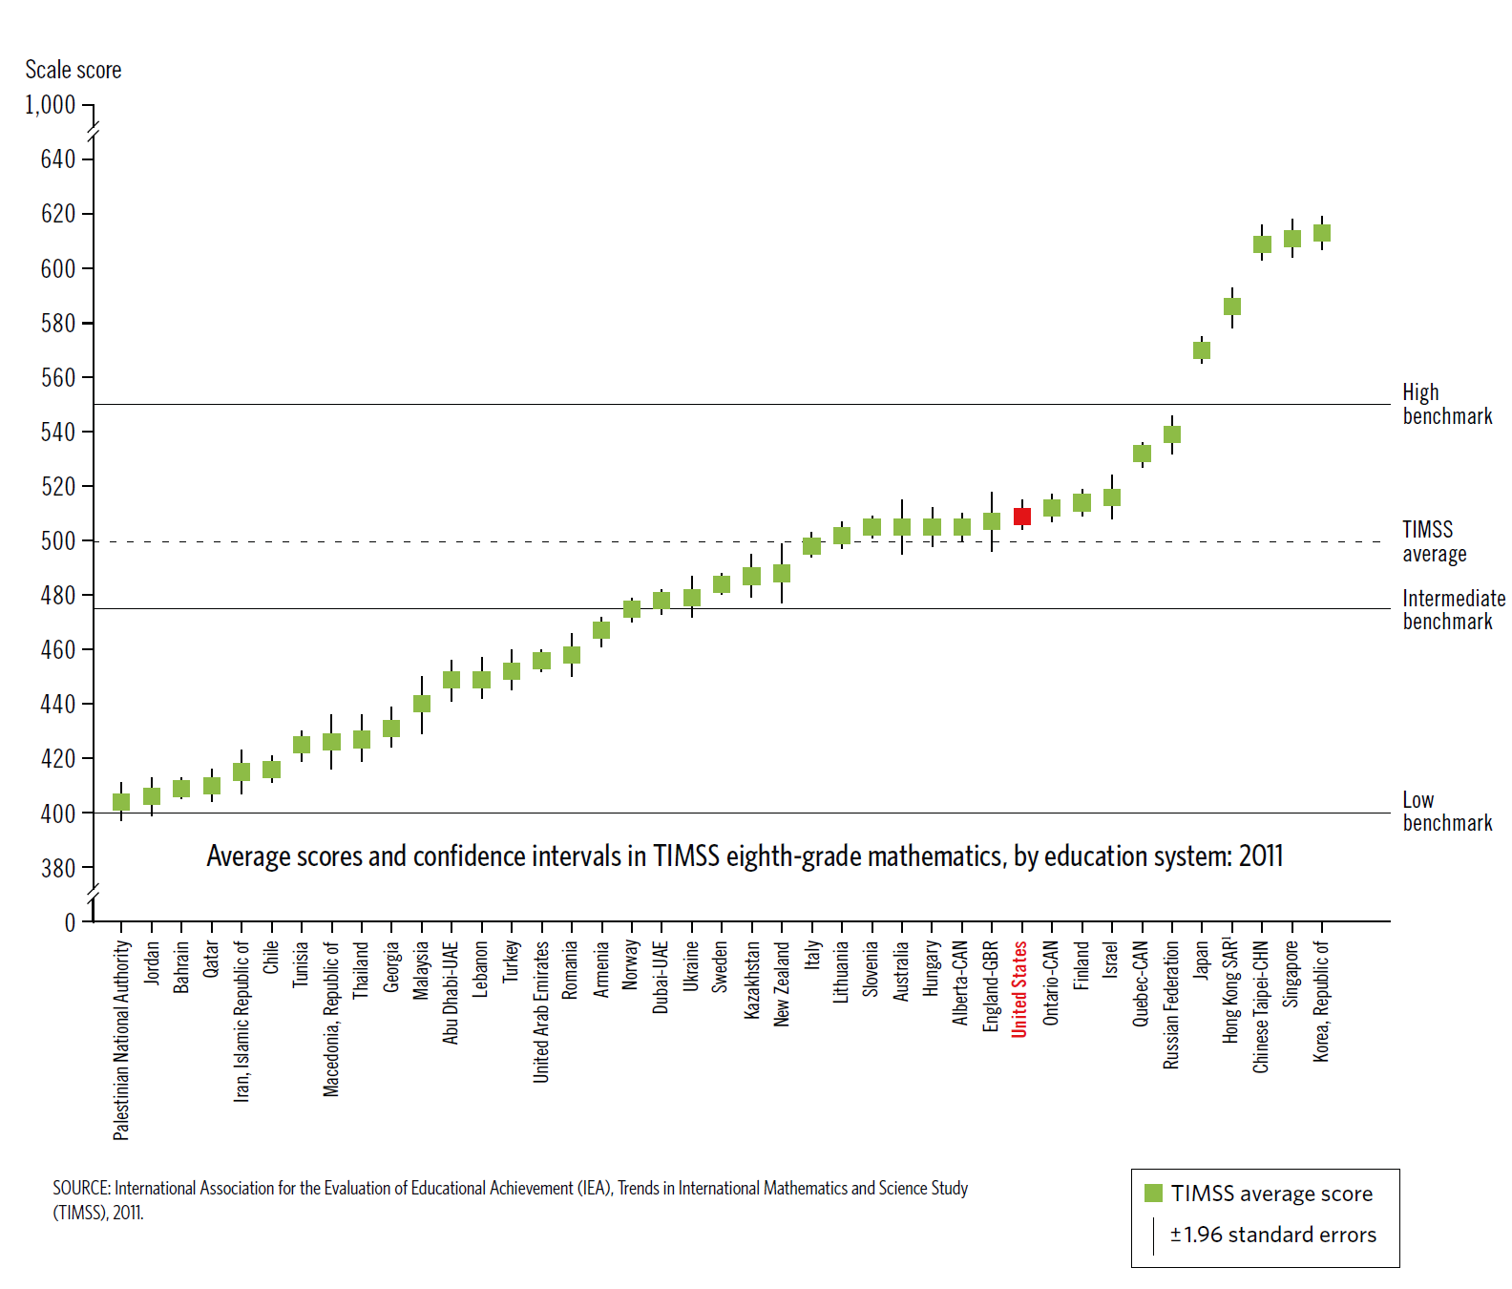
2011 TIMSS Results: Math
United States

Slide 9
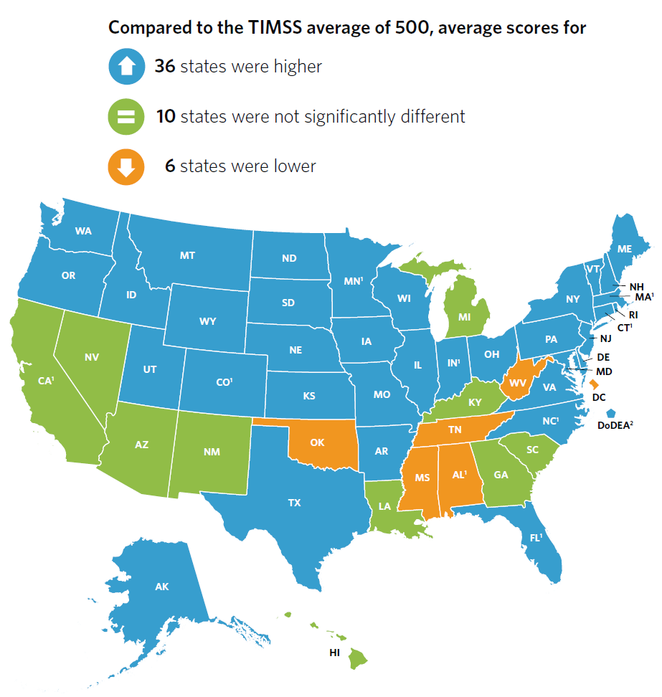
State Math Results

Slide 10
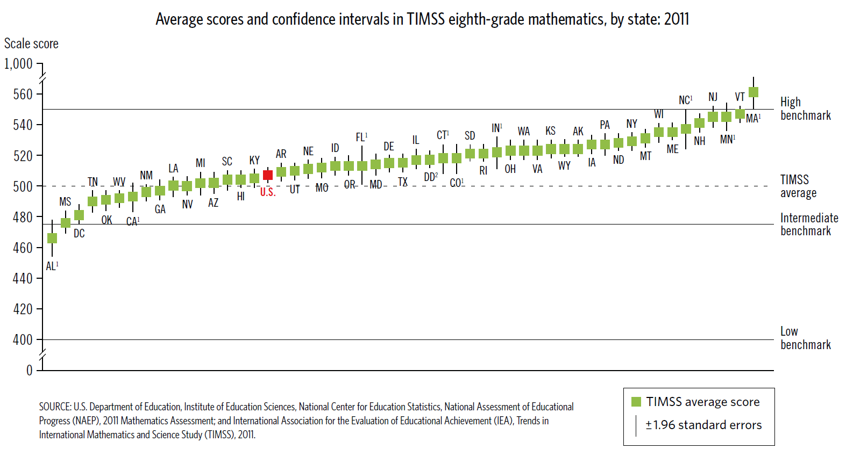
State Results: TIMSS Math Benchmarks
WYOMING

Slide 11
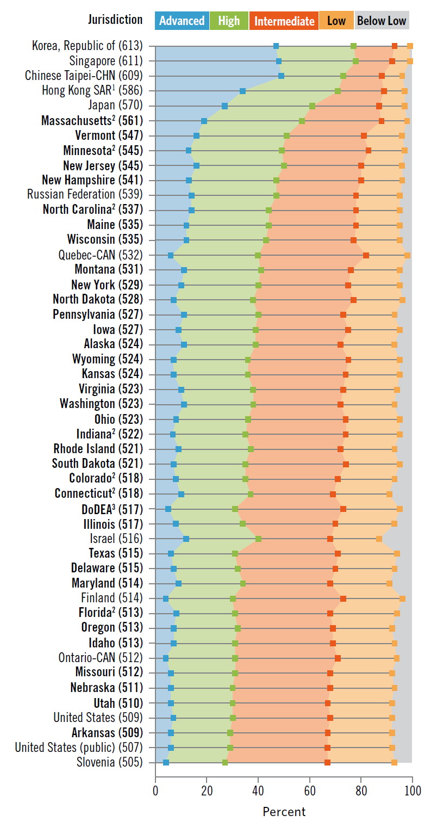
Benchmark Results: States and Countries with Above Average TIMSS Mathematics Scores, ONLY
WY
Selected country and state benchmark results:
Jurisdiction | % Advanced | % High and Above | % Intermed. and above
Korea | 47 | 77 | 93
Massachusetts | 19 | 57 | 88
WYOMING | 7 | 36 | 75
Finland | 4 | 30 | 73
Nebraska | 6 | 30 | 68
United States | 6 | 29 | 67

Slide 12
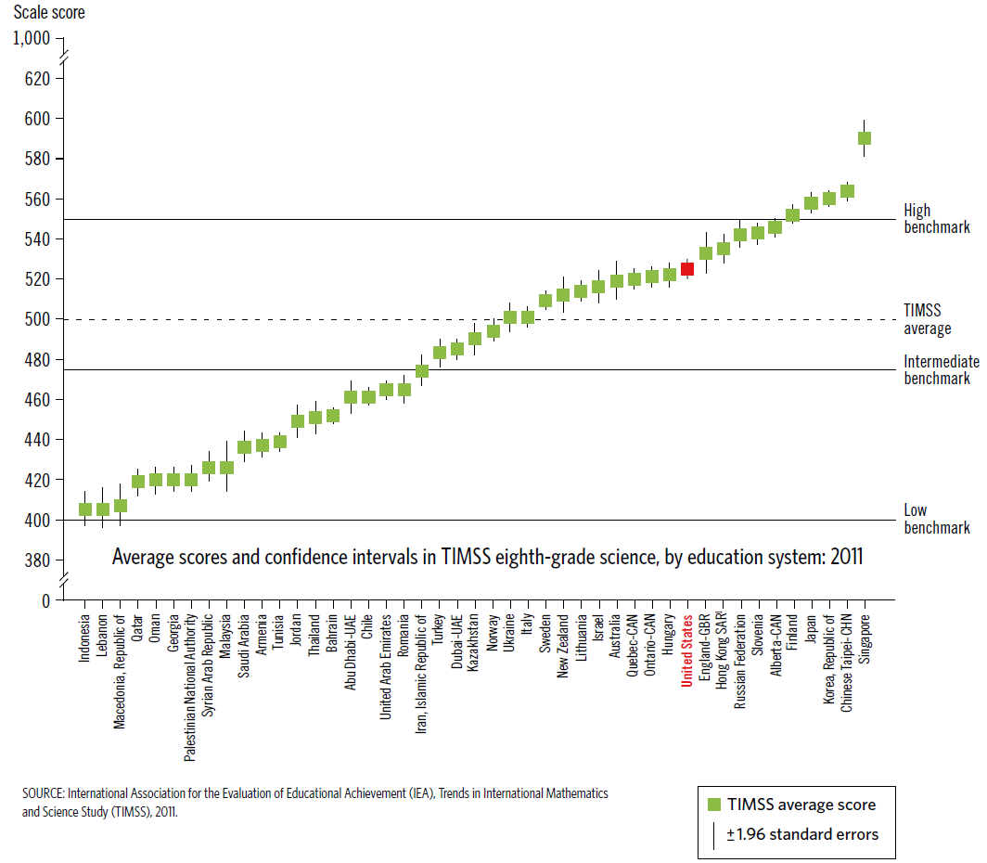
2011 TIMSS Results: Science
United States

Slide 13
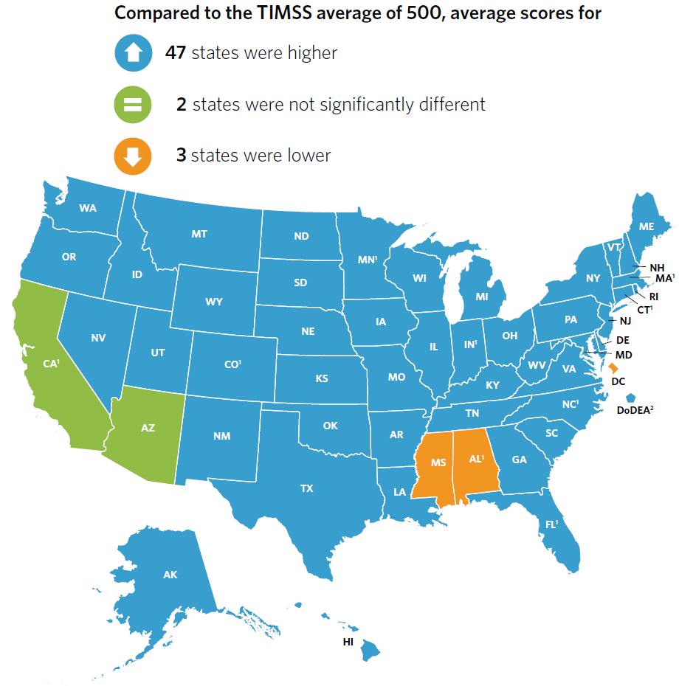
State Science Results

Slide 14
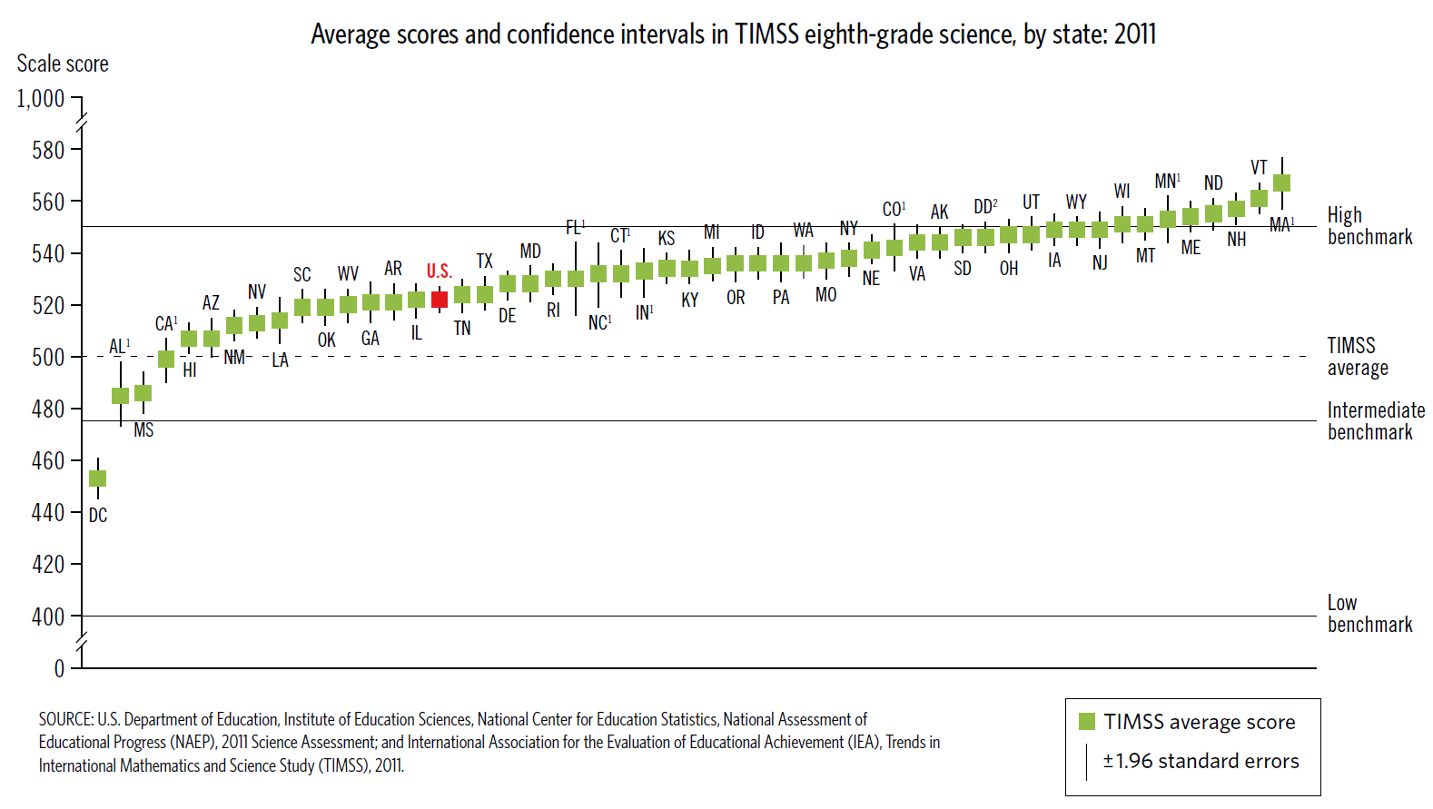
State Results: TIMSS Science Benchmarks
WYOMING

Slide 15
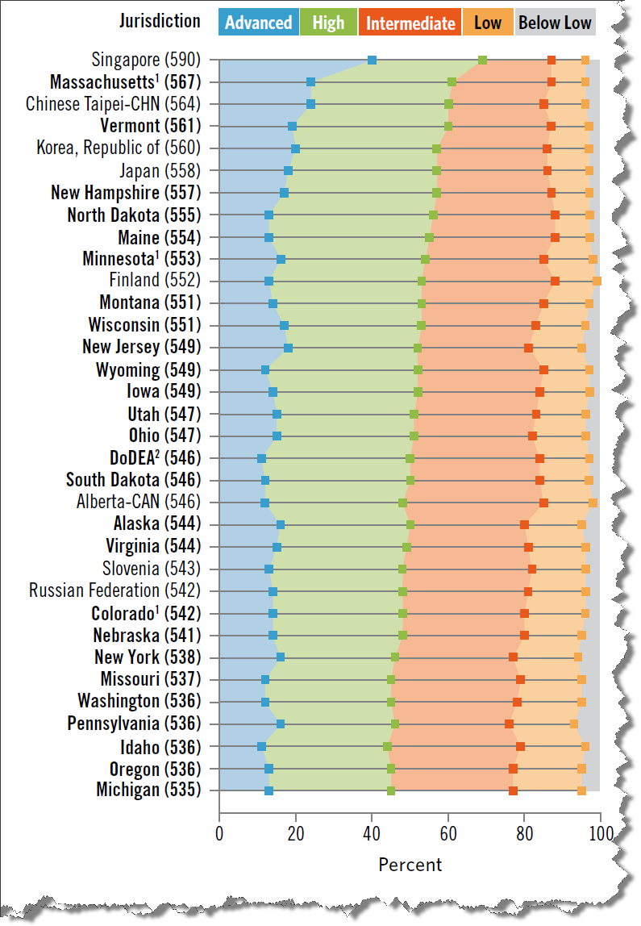
Benchmark Results: States and Countries with Above Average TIMSS Science Scores, ONLY
WY
Selected country and state benchmark results:
Jurisdiction | % Advanced | % High and Above | % Intermed. and above
Singapore | 40 | 69 | 87
Massachusetts | 24 | 61 | 87
WYOMING | 12 | 52 | 85
Idaho | 11 | 44 | 79
Hong Kong | 9 | 47 | 80
United States | 9 | 39 | 73

