Slide 1
Wyoming 21st Century Community Learning Centers Cohort 10 Application Training
August 15, 2014
WEN Network Broadcast
WDE Riverton Office
U.S. Department of Education 21st Century Community
Learning Centers (21 CCLC) federal funds.
CFDA # 84.287C

Slide 2
What Do Readers Look For
Follow the Rubric
Evidence that you understand 21st CCLC as a program
Make it SMART-Specific, Measureable, Attainable, Relevant, Timebound
Intentionality
High Quality
Perceived Need

Slide 3
Cohort 10 Rubric
Section by Section
Priority Points
Optimize Opportunities for Communicating without Diversion or Distraction

Slide 4
What is a Community Learning Center?
*offers academic, artistic, and cultural enrichment opportunities to students and their families during non-school hours (before or after school) or periods when school is not in session (including holidays, weekends or summer recess).
*assists students in meeting state and local academic achievement standards in core academic subjects
*providing the students a variety of high-quality opportunities for academic enrichment that support student learning and development.
*safe environment for students during non-school hours or periods when school is not in session.

Slide 5
WY 21CCLC Goals
Goal 1: To establish community learning centers that help students in high-poverty, low-performing schools meet academic achievement standards.
Goal 2: To offer a broad array of high-quality enrichment activities that are aligned with and complement the regular academic school day while positively affecting student outcomes such as school attendance, academic performance, behaviors and associated risk factors.
Goal 3: To provide programming to engage families of 21st CCLC participants for the purpose of increasing parent/family engagement in learning and developing resiliency through positive home/school relationships.

Slide 6
Allowable Activities
Activities must take place during non-school hours (before or after-school) or periods when school is not in session (holidays, weekends or summer recess).
Grantees are limited to providing activities within the following list and are encouraged to implement a combination of these activities to ensure a comprehensive, quality program:
Highest priority: Academically-aligned programs
Remedial education activities and academic enrichment learning programs, including providing additional assistance to students to allow the students to improve their academic achievement;
Science, technology, engineering and mathematics education activities;
Additional options:
Arts and music education activities;
Entrepreneurial education programs;
Tutoring services and mentoring programs;
Programs that provide after-school activities for limited English proficient students that emphasize language skills and academic achievement;
Recreational activities;
Telecommunications and technology education programs;
Programs that promote parental involvement and family literacy;
Programs that provide assistance to students who have been truant, suspended, or expelled, to allow the students to improve their academic achievement;
Drug and violence prevention programs;
Counseling programs;
Character education programs: and
Expanded library service hours;

Slide 7
High Quality Programming
Supportive Social Environment-Safe, engaging environments that motivate and inspire learning outside the regular school day.
Relationships with students and their families
Academic Learning and Skill Building-Combination of academic, enrichment, cultural, and recreational activities.
Program Organization and Structures Designed for Effectiveness
Direct link with regular school day personnel and learning opportunities.
Professional development of staff with outcomes in mind
Consistent and dependable hours of operation.
Ongoing Continuous Improvement Processes across the program spectrum
Promote Autonomy and Responsibility of Youth
Community partnerships
Strategies for retention and attendance
Program focused on engagement and participation
.

Slide 8
Writing Objectives-SMART
Your grant application will have objectives written to address broad 21CCLC goals and the needs of the students. The strategies and action steps define the work. Look at previous year’s results, defined needs and the goals in order to plan your objectives for what you would like to accomplish in the initial year of the grant. You will indicate the status of your objectives at the end of each year and rewrite old or write new objectives each year.
The Difference between goals and objectives:
Goals are broad; objectives are more narrow and specific.
Goals are general intentions; objectives are precise and measurable.
Goals are abstract; objectives are concrete and attainable.
Goals are intangible; objectives are tangible and relevant.
Goals can't be validated as is; objectives can be validated in a timely way.

Slide 9
SMART Objectives
What is a SMART objective?
Developing objectives requires time, orderly thinking and a clear picture of the results expected from program activities. Well written objectives can be developed using the Specific, Measurable, Achievable, Relevant and Time-bound (SMART) approach.
There is no single correct way to write a SMART objective. The real test is to compare the objective statement to the SMART criteria. Asking the following questions can help determine if an objective reflects the SMART criteria?

Slide 10
SMART Objectives continued
Goal of 21CCLC Grants-Improve the academic achievement of students that regularly attend 21CCLC programs
Typical Objective Increase MAP math achievement scores for regular 21CCLC attendees.
SMART Objectives
The percentage of regular attendees who meet or exceed their MAP math expected growth will increase 10% by the end of the school year.
By the end of the 2012/2013 school year, 70% of all regularly attending 21st CCLC students in K-3rd grade will demonstrate “benchmark” reading skills as measured on the DIBELS assessment.

Slide 11
SMART

Slide 12
Afterschool Program Assessment System
Continuous Improvement process for all 21CCLC subgrantees. In budget under Program Quality Evaluation
Year 1 –Budget for professional development and PD stipends for time with staff. Full implementation in Year 2
Continuing Subgrantees- Attended Summer training and will use APT-O, SAYO-S and SAYO-Y (SAYO-T is optional at this point). Budget $1500 for each report (choose: individual by center or grouped)
Focus on Engagement in Learning

Slide 13
Collaboration Requirement
Each non-LEA applicant must actively collaborate with the LEAs and school(s) from which participating students attend to develop and implement the proposed program.
Evidence of the collaboration must be illustrated through meeting documentation that includes references to shared vision building, planned results or outcomes, mutually identified goals, intervention strategies, and activities.

Slide 14
Serving Eligible Districts/Schools
To meet high poverty requirement in the statute, each school served must be at or above 25% F&R lunch.
To obtain Absolute Priority points- 51% of all centers/schools served must be schoolwide Title I or 40% eligible for F&R lunch. (10pts). Schools In Need of Improvement Sec 1116 (5pts).

Slide 15
Application Sections
Contact Information (2 pts)-pg 23
Applicant Information & Competitive Priorities(12 pts)-pg 24
Capacity (9 pts)-pg 25
Populations & Needs Assessment (15 pts)-pg 26
Center Information (6 pts)-pg 26
Typical Program Operations (25 pts)-pg 27
Program Objectives/Strategies/Action Plans (30pts)-pg 28

Slide 16
Application Sections continued
Program Abstract (12 pts)-pg 28
Timeline (10 pts)-pg 29
Professional Development (12 pts)- pg 29
Continuous Improvement and Evaluation (25 pts)- pg 29
Partnerships (15 pts)-pg 29
Sustainability (6 pts)-pg 29
Program Budget (5 pts) and Budget Narrative (25 pts)-pg 30

Slide 17
Scientifically-Based Research
The authorizing statute provides principles of effectiveness (see page 11) to guide applicants in successfully identifying and implementing programs and activities that can directly enhance student learning, one of which includes activities based on scientific research. As defined in Title IX of ESEA, scientifically-based research:

Slide 18
Family Engagement
Make it prominent-know the data
Be innovative
Utilize 21CCLC tools such as You 4 Youth

Slide 19
Students with Special Needs
Be clear about how you will address barriers- “Everyone is welcome…” is a nice sentiment, but how will you act on your organization's beliefs.
Collaboration-Collaboration-Collaboration
ELL- Address Cultural Relevance and Community Needs
Social/Emotional Learning for all-compassion and acceptance

Slide 20
Private and Home School
Collaboration-Collaboration-Collaboration All Federal programs must communicate with private and home school families. Recruit advisors or liaisons.

Slide 21
Alignment-Program Activities
The academic program must be aligned to the respective schools’ curricula, and must help students meet the adopted Wyoming State Standards- as well as local academic improvement areas in the core academic subjects.
They must complement and enhance the academic performance, achievement, and positive youth development of the students.

Slide 22
Alignment-Budget
All expenditures must be linked to the stated objectives, strategies (what), and action plan (how) in the proposal.
Alignment allows for greater clarity when communicating with staff and constituents. Less confusion about which activities (and students) the grant is funding.

Slide 23
Applicant Organizations with Multiple Funding Streams
Creating a clear 21st CCLC program takes intentional effort within a large, multi-faceted, established organization.
21st CCLC program is distinct
How do the purposes and goals of 21st CCLC fit within the organization’s overall strategic plan?
Can specific, new, unique 21st CCLC activities be defined, measured, evaluated, and subjected to a plan for continuous improvement?
Budget aligned to 21st CCLC program operations

Slide 24
OMB Basic Guidelines
OMB=Office of Management and Budget
Cost principles found in the OMB Circulars, soon to be Super Circular
Reasonable and Necessary
Allocable
Supplement vs Supplant

Slide 25
Necessary and Reasonable
Must be necessary for the performance or administration of the grant
Must follow sound business practices:
Arms length bargaining (hint: procurement processes)
Follow federal, state and local laws
Fair market prices
Act with prudence under the circumstances
No significant deviation from established prices

Slide 26
Practical aspects of “necessary”
Do I really need this?
Surplus property/existing resources
Lease vs. purchase
Is this the minimum amount I need to spend to meet my need?
Practical aspects of “reasonable”
Is the expense targeted to valid programmatic/administrative considerations?
Do I have the capacity to use what I am purchasing?
Did I pay a fair rate? Can I prove it?
If I were asked to defend this purchase, would I be comfortable?

Slide 27
Allocable
Can only charge in proportion to the value received by the program
Example: LEA purchases a computer to use 50% in the 21stCCLC program and 50% in State program – can only charge half the cost to 21stCCLC.

Slide 28
Applicant vs Contractor
Subgrantee
Determines who is eligible to participate in a federal program
Has its performance measured against whether the objectives of the federal program are met
Is responsible for programmatic decision making
Is responsible for complying with federal program requirements
Uses the federal funds to carry out a program as compared to providing goods or services for a program

Slide 29
Applicant vs Contractor
Contractor
Provides the goods and services within normal business operations
Provides similar goods or services to many different purchasers
Operates in a competitive environment
Provides goods or services that are ancillary to the operation of the federal program
Is not subject to compliance requirements of the federal program

Slide 30
Positive Youth Development
Positive youth development refers to a philosophy and approach to working with young people that recognizes that:
multiple domains of young people’s development (i.e., cognitive, social, emotional, physical, and moral) are interconnected;
all young people have strengths and prior knowledge that serve as a platform for subsequent development; and
Youth Voice-young people are active agents of their own growth and development.

Slide 31
Plan to Complete Early!
Make a calendar with deadlines
Draft all narratives in Word to cut and paste into GMS
Begin with goals/objectives
Work closely with business managers and payroll if you are unfamiliar with budgeting
Remember that the application is a legal document; be realistic.
Always keep the rubric handy. Decide which priority points are within the scope of your proposed program.
Create an application on GMS

Slide 32
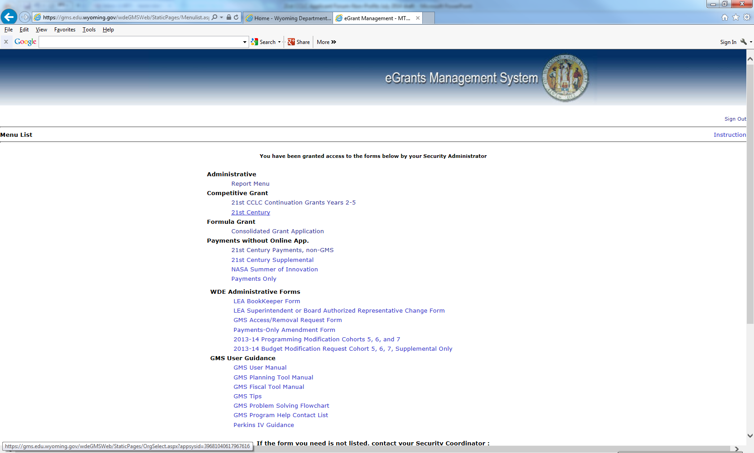
Grants Management System

Slide 33
Cohort 10 GMS Application
Overview and Contact Information
Award Process
Applicant Information and Capacity
Program Details-7 Sub-tabs
Populations and Needs Assessment, Center Info, Typical Operations, Goals/Objectives/Strategies/
Action Plan, Abstract, Partnerships, Sustainability
Budget
Assurances

Slide 34
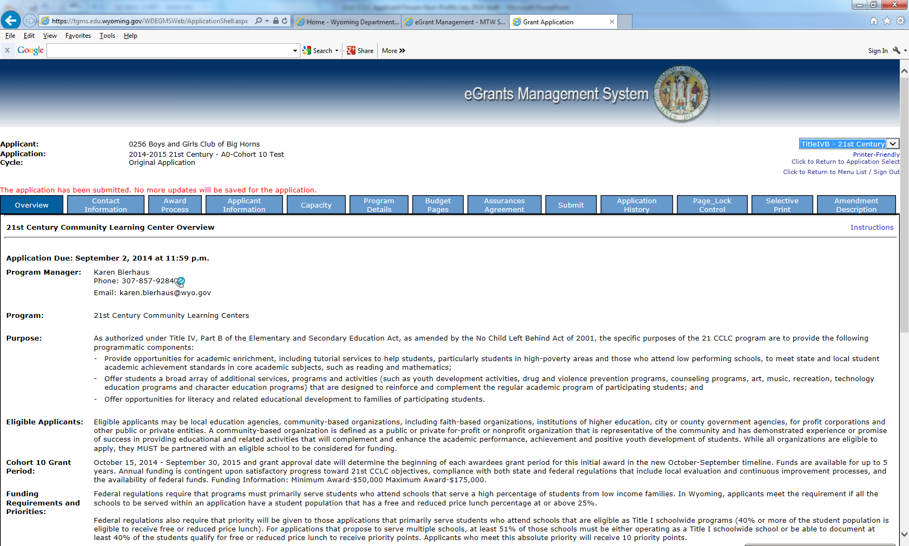

Slide 35
Current Wyoming 21 CCLC Program Locations
Albany County SD #1- Greater Wyoming Big Brothers Big Sisters
Big Horn County SD #2-Big Horn County Health Coalition
Campbell County SD #1-Campbell County 21CCLC Project
Uinta County BOCES
Carbon County SD #1-Boys and Girls Club of Carbon County
Carbon County SD #2-Greater Wyoming Big Brothers Big Sisters- Saratoga
Converse County SD #1
Fremont County SD #1- Lights On In Lander
Fremont County SD #2
Fremont County SD #6
Goshen County SD #1-The PRACTICE Program
Hot Springs County SD #1
Laramie County SD #1-Laramie County Community Partnership
Natrona County SD #1-Natron County Prevention Coalition
Park County SD #1 and Park County SD #6-Boys and Girls Club of Park County
Platte County SD #1-Platte County Prevention Coalition (ending March)
Sweetwater SD #1
Teton County #1
Washakie County SD #1
Weston County SD #1

Slide 36
Discussion and Questions
How much should a program cost per participant/regular?
Do we really need a coordinator?
Can we buy _______?
What’s an MOU?
Who decides whether or not the priority points are to be awarded?

Slide 37
For more information, contact:
Karen Bierhaus
21st CCLC Program Consultant
Wyoming Department of Education
320 West Main St.
Riverton, WY 82501
307-857-9284
karen.bierhaus@wyo.gov

