Slide 1
Associations between Wyoming Third Grade Body Mass Index and the School Food Environment
Marilyn Hammond
Notes:
Introduce self, I am graduating from CSU this spring, This is my thesis project I did while interning for the Epidemiology section of the community and public health division intern for WY health dept.

Slide 2
Introduction
Senate File 93
  Authorized 2009
  Wyoming’s first “Oral Health Initiative”
  Body Mass Index (BMI) measurements taken on a subset of 3rd graders
Current Study
  Goal: Evaluate the potential effects of individual and school factors on being overweight or obese
  Hypothesis: Children in schools with policies and practices encouraging healthy eating and limiting unhealthy foods would have a reduced odds of being overweight or obese than schools without these practices
Notes:
In 2009 the Wyoming Dental Association successfully lobbied the Wyoming legislature to authorize and fund senate file 93, Wyoming’s first Oral Health Initiative
Among other components, the initiative included an oral health screening of all Wyoming third graders, this was seen as an opportunity to combine resources and collect BMI measurements of a subset of third graders for use in analysis and reporting purposes for the Maternal and Child Health section of the Wyoming Health Department.
All third graders were not screened for BMI due to lack of resources to accomplish such a task, sampling methods will be disscussed later in the presentation.
This research project used this BMI data with the goal of evaluating the potential effects of individual and school factors on weight category.
This research project focused on the school food environment specifically with the hypothesis that children in schools with policies and practices encouraging healthy eating and limiting unhealthy foods would have a lower odds of being overweight or obese.

Slide 3
Background
Overweight and obesity are conditions defined as having excess body fat
BMI, calculated from an individual’s height in relation to weight, does not measure body fat, but is highly correlated with direct measures of body fat
Child and adolescent BMI is age and sex specific
Weight Status Category | Percentile Range
Underweight | Less than the 5th percentile
Normal weight | 5th percentile to less than the 85th percentile
Overweight | 85th to less than the 95th percentile
Obese | Equal to or greater than the 95th percentile
Notes:
Overweight and obesity are conditions defined as excess body fat. BMI is a common tool for assessing whether individuals are
overweight or obese because it is easy to obtain, inexpensive and has a high correlation with percent body fat measured by more direct methods.
Unlike adult BMI, child and adolescent BMI is based on percentiles. After the numerical BMI is calculated using their height and weight it is plotted on Centers for Disease Control and Prevention’s sex specific BMI for age growth charts and is given a percentile based on where the child falls in relation to other children of the same age and sex. – describe table -
This study used these definitions to categorize children in this study

Slide 4
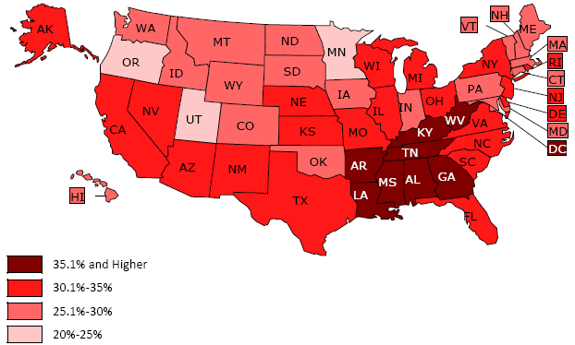
Background
Prevalence of Overweight and Obese Children Ages 10-17 Years in the U.S., NSCH 2007
Nationally, 32% of children ages 10 to 17 are overweight and 16% are obese
In Wyoming, 26% of children ages 10 to 17 are overweight and 10% are obese
Source: National Survey of Children’s Health, 2007
Notes:
The increase in prevelance of overweight and obese individuals is well documented
According to the National Health and Nutrition Examination Survey, It has more than tripled in children ages 6-11 years of age since 1980, from 6.5% to 19.6%.
This map is from National Survey of Children’s Health which used parent reported data to collect BMI, so the prevalence of overweight and obese individuals may be underestimated
As you can see on this map Wyoming is light red indicating a lower prevalence of overweight children ages 10-17 than dark red states
The prevalance of overweight, 26% is significantly lower than the U.S. prevalence of 32%
The prevalence of obese, 10% is also significantly lower the national prevalence of 16%
Although WY is doing better than many states and the nation in general, the number of overweight and obese children is still of concern
Also of concern are disparities between different sub-populations, studies have shown a higher prevalence of overweight non-Hispanic black children, Hispanic children, Mexican American children and American Indian children compared to non-Hispanic white children.
According to the National Health and Nutrition Examination Survey, the number of overweight boys and girls is not significantly different, the National Survey of Children’s Health found that boys were more likely to be overweight or obese than girls.

Slide 5

Background
Childhood Obesity increases:
  Cardiovascular and pulmonary issues
  Hepatic, renal, musculoskeletal, orthopedic and neurological problems
  Early maturation and menstrual irregularities
  Development, learning, behavioral and emotional problems
  Discrimination, stigma, shame, low self-esteem
  Risk of becoming an obese adult
Notes:
Childhood obesity is of concern because it increases the risk of cardiovascular risk factors such as
elevated total cholesterol, triglycerides, insulin or blood pressure
It increases pulmonary risk factors such as
sleep apnea, asthma and exercise intolerance
It may also result in hepatic . . . . Early maturation and .. Development, learning . . .
An obese child may experience discrimination … carry it with them the rest of their lives
It increases the risk of becoming an obese adult where they will face increased risk of, among other things,
heart disease, stroke, certain cancers, type 2 diabetes and increased mortality from these and other complications
Obese individuals may have higher medical costs and lower productivity due to morbidity, and experience discrimination leading to lower social class attainment and lower earnings.

Slide 6

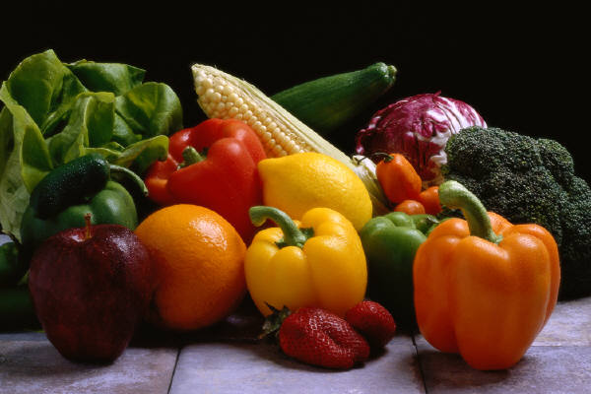


Factors that Influence Becoming Overweight or Obese
Children becoming overweight and obese is the result of a positive energy imbalance: too many calories are consumed and too few are expended
  Genetic
  Metabolic
  Environmental
  Dietary
  Behavioral
  Cultural
  Socioeconomic
Notes:
The simple cause of childhood obesity is that it is the result of an energy imbalance; too many calories being consumed and not enough are expended.
This simplification has led to the focus on how diet and physical activity affect becoming overweight or obese.
However that factors affecting this imbalance can be genetic . .
These factors may act individually or interact with each other and each individual has a unique profile of these factors making obesity a complex issue to prevent and treat

Slide 7

School Food Environment
Children expend ≈ 50% of their daily energy and obtain 33%-58% of their daily energy at school
The School Food Environment consists of:
  School Food Policies
  United State Department of Agriculture (USDA) National School Lunch and Breakfast Programs
    School wellness program
    Department of Defense’s Fresh Fruit and Vegetable Program (DOD FFVP)
    Recess before lunch
  Competitive Foods
    Pouring Rights Contracts
  USDA’s Fresh Fruit and Vegetable
  Program (USDA FFVP)
Notes:
Data for this study was collected in 2009 so I am focusing on the school food environment during the time of the study, however the Healthy Hunger-Free Kids Act was passed in 2010 and has resulted in updates to regulations of the school food environment.
The school food environment is the focus of this study, the school environment is of particular interest because of the amount of time children spend at school, children spend about half their total energy at school and obtain 33% of their energy (if the only eat lunch) and 58% of their energy if they eat breakfast there as well.
The school food environment policies that regulate all foods federally regulated school lunches and breakfasts, and less regulated foods known as competitive foods.
School food policies, such as having a limit on fat content for any one food sold in the school can affect federally regulated and unregulated foods.
School lunches and breakfasts must meet certain recommendations for calories, fat content and daily allowances for protein, vitamin A, vitamin C, iron and calcium, however, schools are given a lot of freedom in which foods to use to meet these recommendations.
Schools that participate in these programs are required to have a wellness program including goals for nutrition education and physical activity.
Some schools choose to utilize the Department of Defense’s fresh fruit and vegetable program for their lunch and breakfast programs.
The DOD’s FFVP partners with schools offering them increased buying power and consistent deliveries to help them obtain a wider variety of high quality fresh fruits and vegetables than would be available through normal USDA purchases.
Studies have shown that children in schools that schedule recess before lunch throw away significantly less vegetables, salad, fruit and milk and consume significantly more nutrients than children in schools where recess is after lunch.
Competitive foods are foods sold in vending machines, snack bars, school stores and a la carte at the cafeteria. The are generally low in nutrients and energy density, meaning that they have a high number of calories per unit of food weight, the only federal regulation at the time of the study on competitive foods was prohibition of sale fo foods of minimal nutritional value in the food service area during school meals. This prohibition includes soft drinks and chewing gum but not candy bars, potato chips, cookies or donuts, which may be sold any time. Competitive foods are often used by schools as supplemental income and are widely available in schools across the U.S.
Pouring rights contracts are agreements that schools sign with vendors such as Coca-Cola that stipulate only their product will be sold at the school (or district). These contracts often result in increased vending availability and advertising on campus.
Another food source in some schools is the USDA FFVP, this program was introduced in 2002 to improve nutrition, reduce childhood overweight and obesity, promote healthy snacking and increase exposure to fruits and vegetables children may not be exposed to at home. The program provides grants to provide free fresh fruits and vegetables to all children at the school, outside of school breakfast and lunch.
Evaluations have reported moderate increase in consumption and improvement of attitudes towards of fruits and vegetables in Wisconsin, but in Mississippi, attitudes towards fruits and vegetables worsened.
Research shown that type of food available in schools is associated with student consumption. A number of studies have shown availability of competitive foods is negatively associated with consumption of fruit and/or vegetables as well as milk with a concurrent increase in consumption of competitive foods.
Only a few studies have gone one step further and analyzed the relationship between school food environment factors in relation to student BMI. A Minnesota study found that school-wide food practices such as using low-nutrient, energy dense foods as rewards in class rewards resulted in a 10% increase in student BMI for each practice allowed. A study using national data found a 2.7 increased odds of obesity in schools where french fries and similar potato products were offered more than once per week as part of the school lunch program

Slide 8
Data Collection
2009-2010 Oral Health Survey
  Height
  Weight
  Age
  Gender
School Food Environment Characteristics were collected from:
  Wyoming Department of Education
  USDA Foods Distribution Program
  U.S. Census Bureau
  Wyoming School Nurses
  School District Business Directors
  School District Food Service Directors
  School Menus

Slide 9
Methods
Study Aims
  Evaluate the associations between overweight and obesity among 3rd grade students and the school characteristics in this study
  Develop multiple logistic regression models to describe the relationship of overweight and obesity with school characteristics in this study along with adjustment for confounding variables
  Compare the associations found for overweight to the associations found for obesity
Study Design
  Ecological cross-sectional survey using a subset of participants in the 2009-2010 Wyoming Oral Health Survey
Notes:
Study aims . . .
The study design was an ecological . . . Schools were sampled rather than individuals, so in every school selected all 3rd graders from that school were asked to participate.
The subset of third graders was chosen to represent the state geographically by dividing the state into 3 regions east, central and west and sampling equally in each region
To represent socioeconomic status we divided school into eligibility for free and reduced lunch tertiles, equal to or below 28%, equal to or below 42% and above 42% and roughly sampled the same number of students in sampling equally in each tertile.

Slide 10




Outcome Variables
Outcome Groups
  Overweight
  Obese
Reference Group
  Underweight and normal weight
Notes:
Status as either overweight or obese were the outcome variables in this study. Underweight was combined with normal weight and all children in either category used as the reference group that either the overweight category and the obese category were compared to, to determine odds ratios

Slide 11
School Food Environment
Domain | Variable
1. Policy or practices of the district or school | Has a nutrition or health advisory council
 | Information available on the nutrient content of USDA-reimbursable meals
 | Has nutrition education in every grade
 | No pouring rights contract
 | Uses DOD’s Fresh Fruit and Vegetable Program
 | Uses USDA’S Fresh Fruit and Vegetable Program
 | Has nutrient requirements as part of its food purchasing specifications
 | Recess is before lunch
2. Availability of competitive foods and beverages | No school store, snack bar, a la carte at the cafeteria, continuous school fundraising activities or teachers activities selling energy-dense nutrient poor-foods
 | No vending machines containing energy-dense nutrient-poor foods available to 3rd graders
3. Content of USDA lunches offered | Fresh fruit or raw vegetables offered daily
 | Fried potatoes not offered
 | Dessert not offered
 | Average meal has less than or equal to 30% calories from fat
 | Average meal has less than or equal to 10% calories from saturated fat
Notes:
In this study, the school environment was defined using a list of 16 variables adapted from the 17 variables designed to measure the school food environment in Finklestein et al.’s “School Food Environments and Policies in US Public Schools”
There were three domains of the environment that were investigated,
the policies and practices (8 variables)
availability of competitive foods and beverages (2)
content of the USDA lunches (5)
All variables were yes/no variables and were coded so that a yes indicated a positive effect and a no indicated a negative effect

Slide 12
Other Variables
Age
Gender
Region - East vs. Central/West
Urban or rural school location
School percent of students eligible for free or reduced lunch – low (below 50%) vs. high (above 50%)
School percent of students in a minority racial or ethnic group – low (below 34%) vs. high (above 34%)
School enrollment size
Notes:
Since the school was unit of measurement, all covariable and confounder data had to be aggregated by school.
age and gender were collected in the Oral health Survey along with weight and height they were considered for inclusion in the model. Age was not associated with BMI at the individual level and was thus excluded from further analysis. Males were more likely to be obese than females at the individual level, when aggregated by school the association dissapeared and they were also excluded from further analysis.
Since region was used as a design variable when sampling it was considered for model development. It was dichotomized into east vs. central and west because the means for central and
Potential confounders considered included, urban or rural school location: determined using Rural-Urban Commuting area codes,
school percent of students frl dichotomized because 1st and 2nd tertile means were similar and the 3rd tertile was different ended up being low (below 50%) and high
. . . Minority was dichotomized because it was not linear and the cutpoint for dichotomization was determined using visual assessment
. . size .

Slide 13

Results
Participation
  42 out of 55 (76.4%) schools participated
  1570 children out of 2012 (78%) of children in the 42 participating schools participated
Study Population
  Gender
    816 (52%) were male and 754 (48%) were female
  Age
    5 (<1%) were 7 years of age
    1173 (75%) were 8 years of age
    385 (25%) were 9 years of age
    8 (<1%) were 10 years of age
Notes:
The study had a high participation rate for both schools and students, over 70%. 42 schools and 1570 students participated
More students were male and the age range was narrow, most students were 8 years of age

Slide 14
Total, Male and Female Numbers of Children by BMI Category
Weight Category | Number of Children (Percentage of Total) | Number of Male Children (Percentage of Males) | Number of Female Children (Percentage of Females)
Underweight | 37 (2.4%) | 12 (1.5%) | 25 (3.3%)
Normal Weight | 1041 (66.3%) | 523 (64.1%) | 518 (68.7%)
Overweight | 248 (15.8%) | 137 (16.8%) | 111 (14.7%)
Obese | 244 (15.5%) | 144 (17.7%) | 100 (13.3%)
Notes:
The numbers of overweight and obese students are consistent with estimates from national surveys. The majority of children were normal weight but over 30% were overweight or obese. A significantly higher percentage of males were obese than females.

Slide 15
Descriptive Statistics: Average School Prevalence of Overweight and Obese Children
Prevalence | Mean | Standard Deviation | Minimum | Median | Maximum
Overweight Children | 31.7% | 12.5% | 6.5% | 31.6% | 74.1%
Obese Children | 16.2% | 9% | 2.5% | 13.8% | 44.4%
Notes:
Here are the statistics for the prevalance of overweight and obese children by school
The mean prevalence of overweight children per school was 31.7% with a range of 6.5% to 74.1%
The mean prevalence of obese children per school was 16.2% with a range of 2.5% to 44.4%

Slide 16
Main Effects: Policy or Practices of the District or School
Domain | Variable | Number of Schools | Percent of Schools
Policy or practices of the district or school | Has a nutrition or health advisory council | 23 | 54.8%
 | Information available on the nutrient content of USDA-reimbursable meals | 39 | 92.9%
 | Has nutrition education in every grade | 33 | 78.6%
 | No pouring rights contract | 31 | 73.8%
 | Uses DOD’s Fresh Fruit and Vegetable Program | 31 | 73.8%
 | Uses USDA’s Fresh Fruit and Vegetable Program | 20 | 47.6%
 | Has nutrient requirements as part of its food purchasing specifications | 16 | 38.1%
 | Recess is before lunch | 18 | 42.9%
Notes:
Discuss variables by domain:
The most common policy or practice of a district or school was having information available on the nutrient content of school meals,
the little over 70% of schools had nutrition education in every grade, no pouring rights contract, and/or used the DOD’s FFVP.
A little over half had a nutrition or health advisory council a
little less than half used the USDA’s FFVP and/or had recess before lunch.
Only about 40% had nutrient requirements for food purchasing.

Slide 17
Main Effects: Availability of Competitive Foods and Beverages
Domain | Variable | Number of Schools | Percent of Schools
Availability of competitive foods and beverages | No school store, snack bar, a la carte at the cafeteria, continuous school fundraising activities or teachers activities selling energy-dense nutrient-poor foods | 36 | 85.7%
 | No vending machines containing energy-dense nutrient-poor foods available to 3rd graders | 41 | 97.6%
Notes:
The majority of schools had limited access to competitive foods, only one school had a vending machine
6 schools

Slide 18
Main Effects: Content of USDA Lunches Offered
Domain | Variable | Number of Schools | Percent of Schools
Content of USDA lunches offered | Fresh fruit or raw vegetables offered daily | 27 | 64.3%
 | Fried potatoes not offered | 36 | 85.7%
 | Dessert not offered | 18 | 42.9%
 | Average meal has less than or equal to 30% calories from fat | 37 | 88.1%
 | Average meal has less than or equal to 10% calories from saturated fat | 29 | 69.1%
Notes:
About 90% of schools met the reccomendation of an average meal having less than or equal to 30% calories from fat,
although only 60% met the recommendation of having 10% of calorie from saturated fat.
About 85% did not offer fried potatoes and about 65% offered fresh fruit or raw vegetables daily.
Only about 40% did not offer dessert.

Slide 19
Descriptive Statistics: Other Variables
Variable | Mean | Standard Deviation | Minimum | Median | Maximum
Percent minority | 22.9% | 19.0% | 3.0% | 17.4% | 99.0%
Percent eligible for free or reduced lunch | 44.1% | 18.4% | 7.2% | 44.1% | 100.0%
School Enrollment | 293 | 92 | 108 | 307 | 460
Notes:
The mean percent of minority was low, 22.9%. Although one school had almost 100% minority you can see that 75% of schools were below 26.8% minority.
The mean percent of free and reduced lunch was 44.1%. Again, one school had 100% FRL, but most schools were below 52.8%
The mean school enrollment was about 300 and ranged from 108 to 460

Slide 20

School Environment: Urban and Rural Categories
Urban Large Rural Small Rural Isolated | 15 12 8 7 | 35.7% 28.6% 19.1% 16.7%
Notes:
There was a pretty good spread of urban and rural schools included in this study, the majority as you would expect in Wyoming, were rural schools

Slide 21

Factors Influencing Being Overweight in this Study
Using the DOD’s FFVP decreased the odds of students being overweight by 22% (OR: 0.78, 90% CI: 0.56, 1.08)
Offering fresh fruit or raw
vegetables daily decreased the
odds of students being overweight
by 26% (OR: 0.74, 90% CI: 0.54,
1.00)
Notes:
The final model: explain final model
contained the variables, uses DOD’s FFVP and fresh fruit and vegs offered daily
Final model adjusted for percent minority (high low) and percent free and reduced lunch (high low) and the model that was not adjusted were not different. Both variables were protective against being overweight.
Children in schools using the DOD’s FFVP had 22% lower odds of being overweight than children in schools that did not use the DOD’s FFVP.
Children in schools serving fresh fruit and vegetables daily in school lunches had a 26% lower odds of being overweight than children in schools not serving fresh fruit and vegetables daily

Slide 22

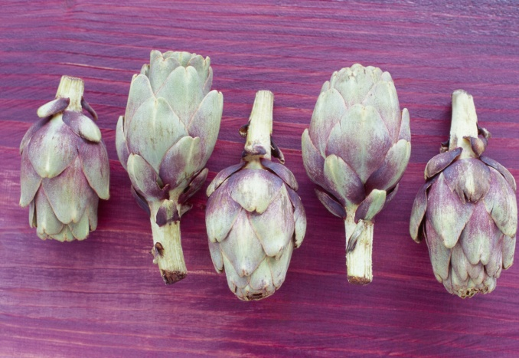
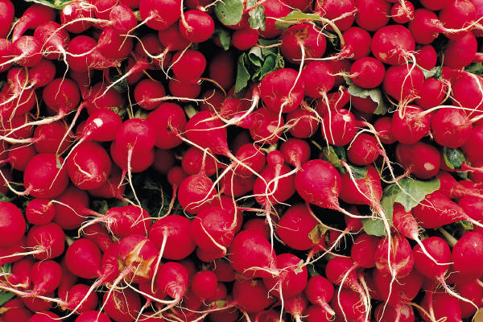
Factors Influencing Being Obese in this Study
Using the USDA’s FFVP decreased the odds of students being obese by 32% (OR: 0.68, 90% CI: 0.46, 1.00)
Offering fresh fruit or raw vegetables daily decreased the odds of students being obese by 32% (OR: 0.68, 90% CI: 0.44, 1.00)
Notes:
The final model contained the variables, uses the USDA’s FFVP and fresh fruit and vegs offered daily
Adjusted for percent minority (high low), percent free and reduced lunch (high low) and region and the model that was not adjusted were not different.
Both variables were protective
Children in schools using the USDAs FFVP had 32% lower odds of being obese than children in schools that did not use the USDA’s FFVP.
Children in schools serving fresh fruit and vegetables daily in school lunches had a 34% lower odds of being obese than children in schools not serving fresh fruit veg everyday

Slide 23
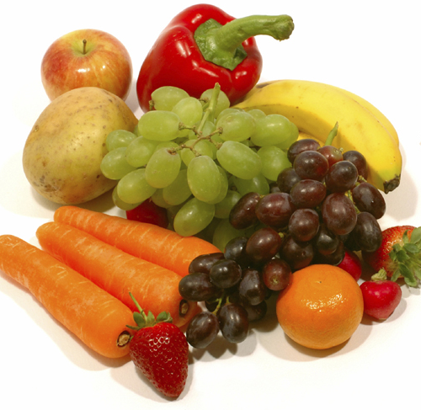
Discussion
Limitations
  Cross sectional
  Ecological
  Small sample size
Strengths
  High participation
  Agreement between overweight and obese models
  Results applicable at an ecological level
Conclusions
  These study results show that schools that make fresh fruits and vegetables available to children may reduce the odds of them being overweight or obese
Notes:
This study was cross sectional, so it is impossible to tell whether the school environment might have a potential causal relationship on the children in the school being overweight or obese
It’s ecological so it’s impossible to tell whether policies are affecting children at the individual level and there is potential that our conclusions are actually ecologic fallacy – explain ecologic fallacy
The sample size was only 42 schools, compared to over 700 schools in previous studies that looked at similar things, so power is low
(describe power)
However, participation was high and there was agreement between the overweight and obese models, with fresh fruits and vegetable availability being protective. consistent
Although it is uncertain the affects on individuals, increasing fresh fruit and vegetable availability is an easier intervention than attempting individual behavior change.
Conclusion
I hope you enjoyed my presentation and I will now open it up for questions

