Slide 1
Proposed Standards for Career & Vocational Education, Social Studies, Physical Education, & Science
Presented to the State Board of Education
November 5, 2013 by Laurie Hernandez

Slide 2
Committee Process
Working in grade-band sub-groups & full committee, each committee did the following:
Review and evaluate the current WY Content & Performance Standards
Review and evaluate other standards (national, other states, CCSS, ISTE, CCTC)
With consensus, determine committee’s direction (keep current, revise current, create new, or adopt other state / national standards)
Notes:
All four committees followed the same process. CCTC = Common Career Technical Core

Slide 3
Standards Review & Adoption Timeline
Standards Review / Revision Starts
June 18-19, 2012
Casper, WY
Grade Band Meetings
12 - 16 months
Organized by Committee Leader
Content Committee Meetings - WEN
- Spring 2013
Fall 2012
Final Content Committee Meetings
Summer 2013
Riverton or Thermopolis?
Standards Formatting and Finalizing
If approved, open Public Comment Period - 45 days
Public Comments Presented to the State Board of Education
If approved, Standards Sent to the Governor for Signature - has 75 days to review
Standards Presented to the State Board of Education
Additional Public Comment Hearings (optional)

Slide 4
Results from Teacher Surveys
 | Survey Dates | # Took Survey | % Who Agree Provide Clear Learning Progressions Across Grade Levels | % Who Agree Provide Clear Learning Progressions Throughout Each Standard
C/VE | May 20 – June 20, 2013 | 37 | 89.2% | N/A
Science | Aug. 12 – Sept. 4, 2013 | 34 | 76% | N/A
Social Studies | Aug. 12 – Sept. 4, 2013 | 15 | 73% 11 / 15 | 73% 11 / 15
Physical Ed. | Aug. 12 – Sept. 4, 2013 | 20 | 90% | 80%

Slide 5
Results from Teacher Survey (cont.)
 | % Who Rank Overall Structure as: |  |  | % Who Agree Standards:
 | Favorable | Impartial | Dislike | Are Appropriately Challenging | Prepare Students for C&CR or Lifetime Physical Activity (P.E. only)
C/VE | 89.2% | N/A | 10.8% | 86.5% | 86.5%
Science | 58% | 21% | 21% | 67% | 73%
Social Studies | 47% | 33% | 20% 3 / 15 | 93% | 80%
Physical Ed. | 60% | 35% | 5% | 90% | 85%
Notes:
Appropriate Challenging, yet accessible for students

Slide 6
Results from Teacher Survey (cont.)
 | % Who Rank the Newly Revised Standards as:
 | “An Improvement” or Better | “Neither Better Nor Worse” | “Not Preferred”
Social Studies | 36% | 64% | 0%
Physical Ed. | 50% | 40% | 10%

Slide 7
Results from Teacher Survey (cont.)
 | % Who Agree Standards Accommodate for the Diversity of Disciplines within C/VE | % Who Agree Science Standards Address the Content Areas within Science
C/VE | 91.2%
Science |  | 82%

Slide 8
Proposed Standards for Career / Vocational Education
Presented to the SBE
November 5, 2013

Slide 9
Key Changes to C/VE Standards
Increase depth
Create Technical Literary Standard to support the 21st Century learner and career-ready students

Slide 10
Proposed C/VE Standards
Stand-ard | Standard Title | Standard Objective
1 | Career Development and Readiness | Students demonstrate career planning and employability skills.
2 | Communication and Collaboration | Students develop the skills necessary to effectively lead, collaborate, and communicate.
3 | Critical Thinking and Problem Solving | Students use critical thinking skills to plan and conduct research, manage projects, solve problems, and make informed decisions using appropriate technology tools, and resources.

Slide 11
Proposed C/VE Standards (cont.)
Stand-ard | Standard Title | Standard Objective
4 | Technical Literacy | Students effectively read, evaluate, write, and communicate technical information.
5 | Technical Proficiency and Productivity | Students safely, ethically, and productively use existing and new technologies and systems.

Slide 12
PLDs – Performance Level Descriptors – C/VE
 | Advanced Students: | Proficient Students: | Basic Students: | Below Basic Students:
1. | evaluate, explore, understand and verbalize | compare, explore and identify | occasionally complete, limited understanding | require significant or extensive support
3. | independently, consistently, effectively and accurately | effectively and accurately | limited ability, limited verbal and written means | require significant assistance or extensive support
4. | independently & successfully | effectively select, read, interpret, evaluate and communicate | limited ability, need assistance | require significant assistance or extensive support

Slide 13
QUESTIONS? Catherine Reeves WDE Consultant

Slide 14
Proposed Standards for Social Studies
Presented to the SBE
November 5, 2013

Slide 15
Key Changes – S.S.
Current WY Social Studies Standards | Draft WY Social Studies Standards
Five Standards | Six Standards - A standard was added to include literacy and technology
Grade bands: K-4, 5-8, and 9-12 | Grade bands: K-2, 3-5, 6-8, and 9-12
Organized with standard, benchmarks and PLDs for one grade band on one page | Organized with benchmarks and PLDs for all grade bands together on one page
Benchmarks are very broad | Benchmarks include examples to help explain the purpose of the benchmark
Notes:
Add standard for literacy and technology
Break out Elementary Grade Band
Multi-Grade View of Benchmarks and PLDs
Add examples to help explain the purpose of the benchmark

Slide 16
Proposed S.S. Standards
Stand-ard | Standard Title | Standard Objective
1 | Citizenship, Government, and Democracy | Students analyze how people create and change structures of power, authority, and governance to understand the continuing evolution of governments and to demonstrate civic responsibility.
2 | Culture and Cultural Diversity | Students demonstrate an understanding of the contributions and impacts of human interaction and cultural diversity on societies.
3 | Production, Distribution, and Consumption | Students describe the influence of economic factors on societies and make decisions based on economic principles.

Slide 17
Proposed S.S. Standards
Stand-ard | Standard Title | Standard Objective
4 | Time, Continuity, and Change | Students analyze events, people, problems, and ideas within their historical contexts.
5 | People, Places, and Environ-ments | Students apply their knowledge of geographic themes (location, place, movement, region, and human/environment interactions) and skills to demonstrate an understanding of interrelationships among people, places, and environment.
6 | Technology, Literacy, and Global Connections | Students use technology and literacy skills to access, synthesize, and to evaluate information to communicate and apply social studies knowledge to global situations.

Slide 18
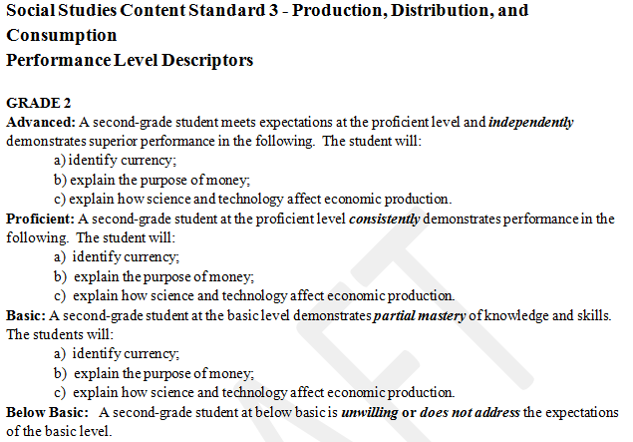
Performance Level Descriptors (PLDs): determine student performance on the benchmarks
Descriptors help teachers assess where students are performing in relation to the benchmarks, and ultimately, the standards.

Slide 19
QUESTIONS? Stephanie Brady WDE Consultant

Slide 20
Proposed Standards for Physical Education
Presented to the SBE
November 5, 2013

Slide 21
Key Changes – P.E.
Current WY Physical Education Standards | Draft WY Physical Education Standards
Grade bands: K-4, 5-8, and 9-12 | Grade bands: K-2, 3-5, 6-8, and 9-12
Benchmarks are left vague | Benchmarks include suggested activities to clarify where they may fit into the curriculum
No links to literacy/Common Core | Links to Common Core to show the connections between the PE and Literacy Standards
PLDs: Four Performance Level Descriptors | PLDs: Reduced to Three Performance Level Descriptors
Notes:
Break out Elementary Grade Bands
Include suggested activities for benchmarks
Link P.E. Standards to ELA Standards (show literacy connection)
Reduce PLDs to three (3) [students are Proficient, Above, or Below)

Slide 22
Proposed P.E. Standards
Stand-ard | Standard Title | Standard Objective
1 | Movement | The learner will demonstrate competency in a variety of movement skills and patterns and demonstrate an understanding of movement concepts, principles, strategies, and tactics as they apply to the learning and performance of physical activities.
2 | Fitness | Students demonstrate personal and social responsibility, understand the benefits of physical activity, and respect diversity among people in physical activity settings.

Slide 23
Proposed P.E. Standards (cont.)
Stand-ard | Standard Title | Standard Objective
3 | Personal and Social Behavior | Students demonstrate personal and social responsibility, understand the benefits of physical activity, and respect diversity among people in physical activity settings.

Slide 24
QUESTIONS? Stephanie Brady WDE Consultant

Slide 25
Proposed Standards for Science
Presented to the SBE
November 5, 2013

Slide 26
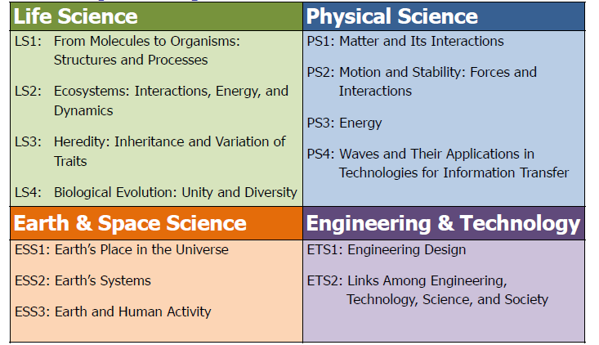
Disciplinary Core Ideas
Notes:
These are considered the most essential ideas in the major science disciplines.

Slide 27
NGSS Matrix of Standards by Grade Level and Topic
 |  | Life Science | Earth Space Science | Physical Science | Engineering & Technology
 | K | Organisms and Their Environments | Weather | Structure and Properties of Matter
 | 1 | Structure and Function | Patterns and Cycles | Light and Sound
 | 2 | Interdependence of Organisms and their Surroundings | Earth's Changing Surface | Structure, Properties, and Interactions of Matter Pushes and Pulls
 | 3 | Environmental Impacts on Organisms Structure, Function, and Stimuli | Weather, Climate, and Impacts | Interactions of Forces
 | 4 | Life Cycles and Traits | Processes that Shape the Earth | Energy Waves
 | 5 | Matter and Energy in Ecosystems | Earth Systems and Their Interactions Stars and the Solar System | Structure, Properties, and Interactions of Matter
Middle School |  | Structure, Function, and Information Processing Growth, Development, and Reproduction of Organisms Matter and Energy in Organisms and Ecosystems Interdependent Relationships in Ecosystems Natural Selection and Adaptations | Space Systems History of Earth Earth's Interior Processes Earth's Surface Processes Weather and Climate Human Impacts | Structure and Properties of Matter Chemical Reactions Forces and Motion Interactions of Forces Energy Waves and Electromagnetic Radiation | Engineering Design Links Among Engineering, Technology, Science and Society
High School |  | Structure, Function, and Information Processing Matter and Energy in Organisms and Ecosystems Interdependent Relationships in Ecosystems Natural Selection and Evolution Inheritance and Variation of Traits | Space Systems History of Earth Earth's Systems Climate Change Human Sustainability | Structure and Properties of Matter Chemical Reactions Nuclear Processes Forces and Motion Interactions of Forces Energy Forces and Energy Waves Electromagnetic Radiation | Engineering Design Links Among Engineering, Technology, Science and Society
Notes:
There are logical learning progressions and scaffolding from one level to the next. Each teacher at each level can understand the rationale for teaching the concepts and practices that lead to the next grade level.

Slide 28
Number of Standards in Different Grades & Topics
 | Life Science | Earth & Space Science | Physical Science | Engineering & Technology
K-2 | 3 Standards | 3 Standards | 4 Standards | *
3-5 | 4 Standards | 4 Standards | 4 Standards | *
6-8 | 5 Standards | 6 Standards | 6 Standards | 2 Standards
9-12 | 5 Standards | 5 Standards | 9 Standards | 2 Standards
* In grades K-5, Engineering and Technology
Standards are included in other domains

Slide 29
QUESTIONS? Dr. Jim Verley WDE Consultant

Slide 30
“Education is the kindling of a flame, not the mere filling of a vessel” Socrates

Slide 31
Thank You

Slide 32
Committee Members
# of Members Who Are: | C/VE | S.S. | P.E. | SCIENCE
Total # of Members: | 34 | 35 | 23 | 39
Teachers (content, SPED, ELL, or STEM) | 25 | 28 | 15 | 32
Other District Personnel / Administrator / Curriculum Director / Coach | 4 | 5 | 6 | 3
Higher Education Professor / Educator | 2 | 1 | 2 | 3
Business Representative | 2
Parent | 1 | 1 |  | 1

Slide 33
Review & Considerations
ISTE Standard |  | C/VE Code
1 | Creativity & Innovation | CV11.3.4
2 | Communication & Collaboration | Standard 2
3 | Research & Information Fluency | Standard 4
4 | Critical Thinking, Problem Solving, and Decision Making | Standard 3
5 | Digital Citizenship | Standard 5, Benchmark 3
6 | Technology Operations and Concepts | Standard 5
ISTE = International Society for Technology in Education

Slide 34
CCTC Career Ready Practices |  | C/VE Code
1 | Act as a responsible and contributing citizen and employee. | CV11.1.4
2 | Apply appropriate academic and technical skills. | n/a
3 | Attend to personal health and financial well-being. | n/a
4 | Communicate clearly, effectively and with reason. | CV11.2.1
5 | Consider the environmental, social and economic impacts of decisions. | CV11.3.4
6 | Demonstrate creativity and innovation. | CV11.3.4
7 | Employ valid and reliable research strategies. | CV11.3.3
8 | Utilize critical thinking to make sense of problems and persevere in solving them. | Standard 3
9 | Model integrity, ethical leadership and effective management. | CV11.2.2
10 | Plan education and career path aligned to personal goals. | CV8.1.1 & 8.1.2
11 | Use technology to enhance productivity. | Standard 5
12 | Work productively in team while using cultural/global competence | CV11.2.3
Notes:
CCTC = Common Career Technical Core

